Slide 1
A More Excellent
Way
1 Corinthians 13

Slide 2

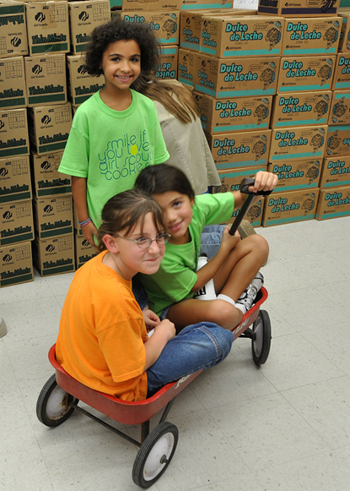
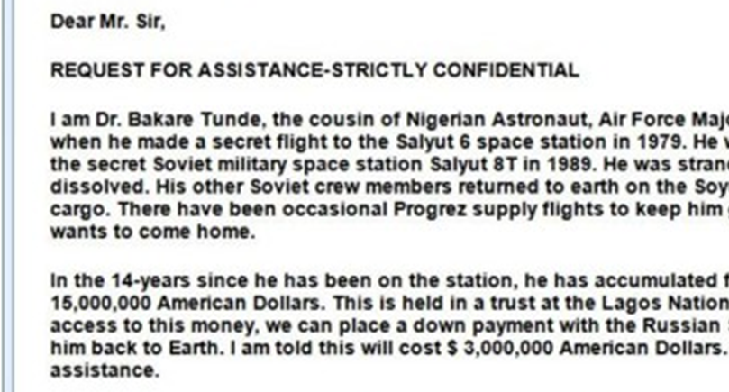

Slide 3
John 13:34-35
A new commandment I give to you, that you love one another: just as I have loved you, you also are to love one another. By this all people will know that you are my disciples, if you have love for one another.”

Slide 4
The Necessity of Love
Verses 1-3

Slide 5
1 Corinthians 13:1
If I speak in the tongues of men and of angels, but have not love, I am a noisy gong or a clanging cymbal.

Slide 6
1 Corinthians 13:2
And if I have prophetic powers, and understand all mysteries and all knowledge, and if I have all faith, so as to remove mountains, but have not love, I am nothing.

Slide 7
1 Corinthians 13:3
If I give away all I have, and if I deliver up my body to be burned, but have not love, I gain nothing.

Slide 8
John 3:16
“For God so loved the world, that he gave his only Son, that whoever believes in him should not perish but have eternal life.

Slide 9
Matthew 22:37-38
And he said to him, “You shall love the Lord your God with all your heart and with all your soul and with all your mind. This is the great and first commandment.

Slide 10
Matthew 22:39-40
And a second is like it: You shall love your neighbor as yourself. On these two commandments depend all the Law and the Prophets.”

Slide 11
Matthew 6:1
Beware of practicing your righteousness before other people in order to be seen by them, for then you will have no reward from your Father who is in heaven.

Slide 12
The Practice of Love
Verses 4-7

Slide 13
1 Corinthians 13:4-7
Love is patient and kind; love does not envy or boast; it is not arrogant or rude. It does not insist on its own way; it is not irritable or resentful; it does not rejoice at wrongdoing, but rejoices with the truth. Love bears all things, believes all things, hopes all things, endures all things.

Slide 14

Patient & Kind
Patient: Able to endure annoying or difficult situations without lashing out

Slide 15
Patient & Kind
1 Peter 2:21-23 – For to this [unjust suffering] you have been called, because Christ also suffered for you, leaving you an example, so that you might follow in his steps. He committed no sin, neither was deceit found in his mouth. When he was reviled, he did not revile in return; when he suffered, he did not threaten, but continued entrusting himself to him who judges justly.

Slide 16
Patient & Kind
Patient: Able to endure annoying or difficult situations without lashing out
Kind: Friendly, generous, and considerate

Slide 17
Patient & Kind
Matthew 7:12 – “So whatever you wish that others would do to you, do also to them, for this is the Law and the Prophets.

Slide 18
Does Not Envy or Boast
& Is Not Arrogant
Envy: to be upset or discontent when someone else has something you want.

Slide 19
Does Not Envy or Boast
& Is Not Arrogant
James 1:17 – Every good gift and every perfect gift is from above, coming down from the Father of lights, with whom there is no variation or shadow due to change.

Slide 20
Does Not Envy or Boast
& Is Not Arrogant
Envy: to be upset or discontent when someone else has something you want.
Boast: to praise yourself

Slide 21
Does Not Envy or Boast
& Is Not Arrogant
1 Corinthians 4:6b-7 – that none of you may be puffed up in favor of one against another. For who sees anything different in you? What do you have that you did not receive? If then you received it, why do you boast as if you did not receive it?

Slide 22
Does Not Envy or Boast
& Is Not Arrogant
Envy: to be upset or discontent when someone else has something you want.
Boast: to praise yourself
Arrogant: puffed up with pride

Slide 23
Does Not Envy or Boast
& Is Not Arrogant
Proverbs 16:18 – Pride goes before destruction, and a haughty spirit before a fall.
1 Corinthians 10:12 – Therefore let anyone who thinks that he stands take heed lest he fall.

Slide 24
Not Rude or Self-Seeking
Rude: behaving in a way that is considered disgraceful or offensive

Slide 25
Not Rude or Self-Seeking
Colossians 4:5-6 – Walk in wisdom toward outsiders, making the best use of the time. Let your speech always be gracious, seasoned with salt, so that you may know how you ought to answer each person.

Slide 26
Not Rude or Self-Seeking
Rude: behaving in a way that is considered disgraceful or offensive
Self-Seeking: focused on personal comfort or gain

Slide 27
Not Rude or Self-Seeking
Philippians 2:3-4 – Do nothing from selfish ambition or conceit, but in humility count others more significant than yourselves. Let each of you look not only to his own interests, but also to the interests of others.

Slide 28
Not Irritable or Resentful
Irritable: Easily angered or annoyed / Having a hot temper

Slide 29
Not Irritable or Resentful
James 1:19-20 – Know this, my beloved brothers: let every person be quick to hear, slow to speak, slow to anger; for the anger of man does not produce the righteousness of God.

Slide 30
Not Irritable or Resentful
Irritable: Easily angered / Having a hot temper
Resentful: Keeping track of wrongs done against you

Slide 31
Not Irritable or Resentful
Ephesians 4:31-32 – Let all bitterness and wrath and anger and clamor and slander be put away from you, along with all malice. Be kind to one another, tenderhearted, forgiving one another, as God in Christ forgave you.

Slide 32
Not Irritable or Resentful
Matthew 6:14-15 – For if you forgive others their trespasses, your heavenly Father will also forgive you, but if you do not forgive others their trespasses, neither will your Father forgive your trespasses. (see also, Matthew 18:21-34)

Slide 33
Does Not Rejoice in Wrongdoing
Rejoices in the Truth
Rejoicing in wrongdoing: Taking satisfaction in someone’s sinful behavior

Slide 34
Does Not Rejoice in Wrongdoing
Rejoices in the Truth
Hebrews 10:29 – How much worse punishment, do you think, will be deserved by the one who has trampled underfoot the Son of God, and has profaned the blood of the covenant by which he was sanctified, and has outraged the Spirit of grace?

Slide 35
Does Not Rejoice in Wrongdoing
Rejoices in the Truth
1 Peter 4:8 – Above all, keep loving one another earnestly, since love covers a multitude of sins.

Slide 36
Does Not Rejoice in Wrongdoing
Rejoices in the Truth
Rejoicing in wrongdoing: Taking satisfaction in someone’s sinful behavior
Rejoicing in the truth: excited for others to grow in their faith

Slide 37
Does Not Rejoice in Wrongdoing
Rejoices in the Truth
Hebrews 10:24-25 – And let us consider how to stir up one another to love and good works, not neglecting to meet together, as is the habit of some, but encouraging one another, and all the more as you see the Day drawing near.

Slide 38
Bears, Believes, Hopes,
& Endures All Things
Bears all things: Doesn’t make a big deal of things that are annoying or irritating.
Believes & hopes all things: Gives others the benefit of the doubt.

Slide 39
Bears, Believes, Hopes,
& Endures All Things
Proverbs 18:2 – A fool takes no pleasure in understanding, but only in expressing his opinion.
Hebrews 6:9 – Though we speak in this way, yet in your case, beloved, we feel sure of better things—things that belong to salvation.

Slide 40
Bears, Believes, Hopes,
& Endures All Things
Bears all things: Doesn’t make a big deal of things that are annoying or irritating.
Believes & hopes all things: Gives others the benefit of the doubt.
Endures all things: Perseveres despite difficulties.

Slide 41
The Eternal Value of Love
Verses 8-13

Slide 42
1 Corinthians 13:8-10
Love never ends. As for prophecies, they will pass away; as for tongues, they will cease; as for knowledge, it will pass away. For we know in part and we prophesy in part, but when the perfect comes, the partial will pass away.

Slide 43
1 Corinthians 13:11-12
When I was a child, I spoke like a child, I thought like a child, I reasoned like a child. When I became a man, I gave up childish ways. For now we see in a mirror dimly, but then face to face. Now I know in part; then I shall know fully, even as I have been fully known.

Slide 44
1 John 2:28
And now, little children, abide in him, so that when he appears we may have confidence and not shrink from him in shame at his coming.

Slide 45
1 Corinthians 13:13
So now faith, hope, and love abide, these three; but the greatest of these is love.

Slide 46
Self-Evaluation

Slide 47
[Your Name] is patient.
[Your Name] is kind.
[Your Name] does not envy.
[Your Name] does not boast.
[Your Name] is not arrogant.
[Your Name]is not rude.

Slide 48
[Your Name] is not self-seeking.
[Your Name] is not irritable.
[Your Name] does not keep a record of wrongs.
[Your Name] does not rejoice in sin.
[Your Name] rejoices in the truth.
[Your Name]bears, believes, hopes, & endures all things.

Slide 49
Applications
Pray and ask God for his help in areas where you see yourself falling short.
Come up with some practical steps to help put it into practice.
Get help from a mature believer.

