Slide 2
Woes Against the Pharisees (Matthew 23:13-39)
Closing Heaven’s Doors
Teaching Others to Sin the Sin of Legalism
Finding Loopholes
Neglecting Justice, Mercy, & Faithfulness
Cherishing Greed & Self-indulgence
Hiding Hypocrisy & Wickedness
Attacking God’s Messengers

Slide 3
Woes Against the Pharisees (Matthew 23:13-39)
Closing Heaven’s Doors
Teaching Others to Sin the Sin of Legalism
Finding Loopholes
Neglecting Justice, Mercy, & Faithfulness
Cherishing Greed & Self-indulgence
Hiding Hypocrisy & Wickedness
Attacking God’s Messengers

Slide 4
Love in Action (1 Corinthians 13:4-7)
[Your name] is patient
[Your name] is kind
[Your name] does not envy
[Your name] does not boast
[Your name] is not arrogant
[Your name] is not rude

Slide 5
Love in Action (1 Corinthians 13:4-7)
[Your name] is not self-seeking
[Your name] is not irritable
[Your name] is not resentful
[Your name] does not rejoice in sin
[Your name] rejoices in the truth
[Your name] bears, believes, hopes, & endures all things.

Slide 6
James 3:2
We all stumble in many ways. Anyone who is never at fault in what they say is perfect, able to keep their whole body in check.

Slide 7

Sticks & Stones…
Proverbs about Our Words

Slide 8
Sticks and stones may break my bones…
…but words can never hurt me.

Slide 9
Sticks and stones may break my bones…
…but words can never hurt me.
…but with his mouth the godless destroys his neighbor. (11:9)
…but the words of the reckless pierce like swords. (12:18)
…but a perverse tongue crushes the spirit. (15:4)
…but the tongue has the power of life and death. (18:21)

Slide 10

Death vs. Life
Proverbs 18:21

Slide 11
Proverbs 18:21
The tongue has the power of life and death,
and those who love it will eat its fruit.

Slide 12

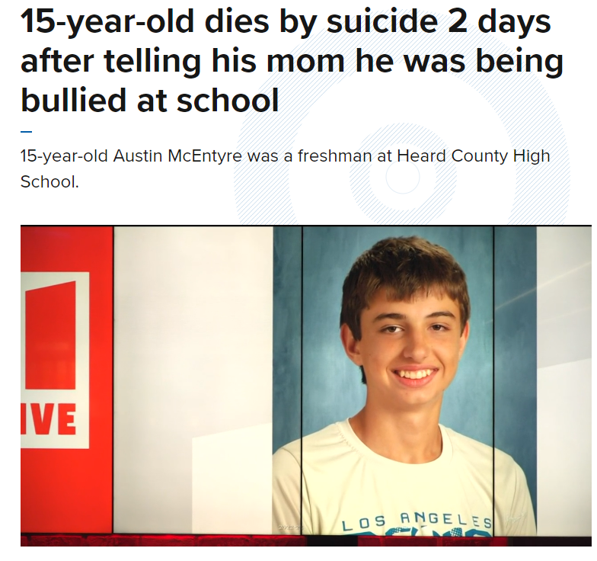

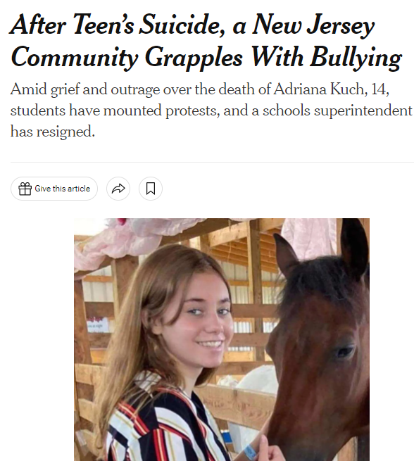
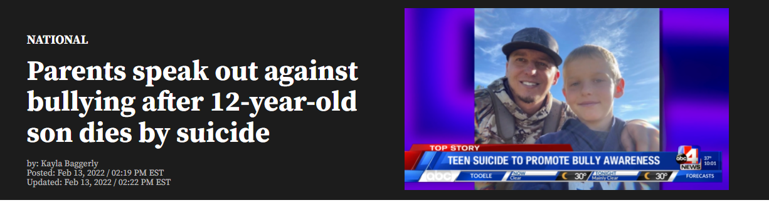

Slide 13


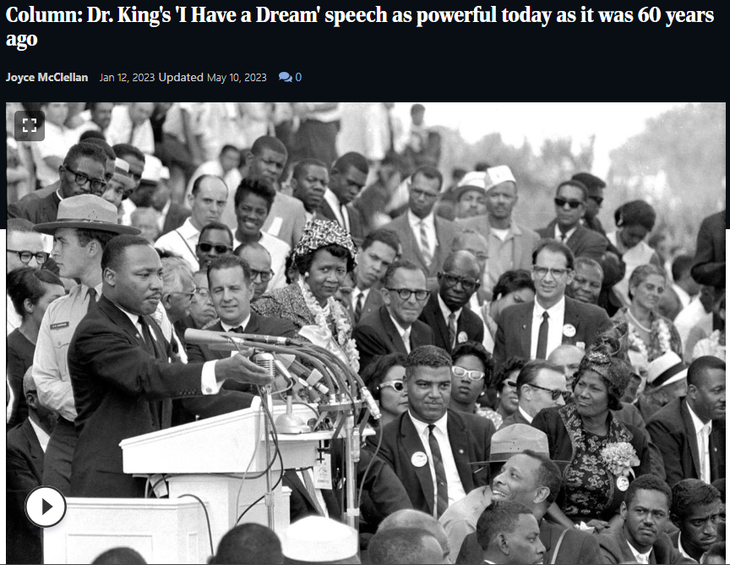

Slide 14
Proverbs 18:21
The tongue has the power of life and death,
and those who love it will eat its fruit.

Slide 15


Slide 16
James 1:26
Those who consider themselves religious and yet do not keep a tight rein on their tongues deceive themselves, and their religion is worthless.

Slide 17
Matthew 12:35-36
A good man brings good things out of the good stored up in him, and an evil man brings evil things out of the evil stored up in him. But I tell you that everyone will have to give account on the day of judgment for every empty word they have spoken.

Slide 18
James 3:1
Not many of you should become teachers, my fellow believers, because you know that we who teach will be judged more strictly.

Slide 19
Proverbs 18:21
The tongue has the power of life and death,
and those who love it will eat its fruit.

Slide 20
Harsh vs. Gentle
Proverbs 15:1

Slide 21
Proverbs 15:1
A gentle answer turns away wrath,
but a harsh word stirs up anger.
Gentle: soft, calm, controlled, and kindly intended

Slide 22
1 Peter 2:20b-23
But if you suffer for doing good and you endure it, this is commendable before God. To this you were called, because Christ suffered for you, leaving you an example, that you should follow in his steps. “He committed no sin, and no deceit was found in his mouth.” When they hurled their insults at him, he did not retaliate; when he suffered, he made no threats. Instead, he entrusted himself to him who judges justly.

Slide 23
Proverbs 15:1
A gentle answer turns away wrath,
but a harsh word stirs up anger.
Gentle: soft, calm, controlled, and kindly intended
Harsh: angry, accusing, dismissive, and/or deliberately offensive

Slide 24
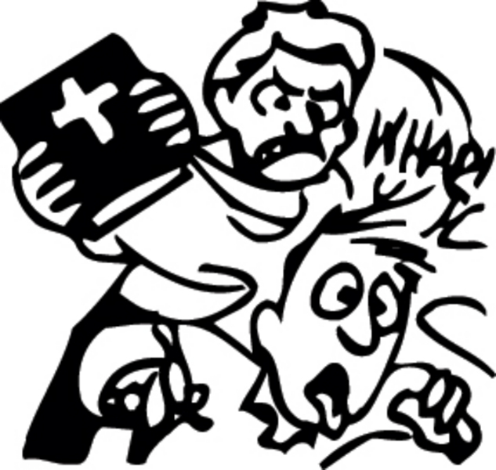
2 Timothy 2:24-26
And the Lord’s servant must not be quarrelsome but must be kind to everyone, able to teach, not resentful. Opponents must be gently instructed, in the hope that God will grant them repentance leading them to a knowledge of the truth, and that they will come to their senses and escape from the trap of the devil, who has taken them captive to do his will.

Slide 25
Proverbs 15:1
A gentle answer turns away wrath,
but a harsh word stirs up anger.

Slide 26
Gossip & Complaining vs. Edifying
Proverbs 16:28

Slide 27
Definitions
Gossip: Talking about someone with bad intent
Complain: Expressing annoyance/dissatisfaction with an event or with the way things are

Slide 28
Proverbs 16:28
A perverse person stirs up conflict,
and a gossip separates close friends.

Slide 29
Proverbs 16:28
There are six things the Lord hates,
seven that are detestable to him:
haughty eyes,
a lying tongue,
hands that shed innocent blood,
a heart that devises wicked schemes,
feet that are quick to rush into evil,
a false witness who pours out lies
and a person who stirs up conflict in the community.

Slide 30
Proverbs 11:13
A gossip betrays a confidence,
but a trustworthy person keeps a secret.

Slide 31
Proverbs 26:17
Like one who grabs a stray dog by the ears
is someone who rushes into a quarrel not their own.

Slide 32
Proverbs 10:14
When words are many, transgression is not lacking,
but whoever restrains his lips is prudent.

Slide 33
Ephesians 4:29-30
Do not let any unwholesome talk come out of your mouths, but only what is helpful for building others up according to their needs, that it may benefit those who listen. And do not grieve the Holy Spirit of God, with whom you were sealed for the day of redemption.

Slide 34
Ask yourself:
Is it true?
Ephesians 4:14-15 – Then we will no longer be infants, tossed back and forth by the waves, and blown here and there by every wind of teaching and by the cunning and craftiness of people in their deceitful scheming. Instead, speaking the truth in love, we will grow to become in every respect the mature body of him who is the head, that is, Christ.

Slide 35
Ask yourself:
Is it true?
Is it kind?
Matthew 7:12 – So in everything, do to others what you would have them do to you, for this sums up the Law and the Prophets.

Slide 36
Ask yourself:
Is it true?
Is it kind?
Is it necessary?
Ephesians 4:29 – Do not let any unwholesome talk come out of your mouths, but only what is helpful for building others up according to their needs, that it may benefit those who listen.

Slide 37
Ask yourself:
Is it true?
Is it kind?
Is it necessary?

Slide 38
Boasting vs. Humility
Proverbs 27:2

Slide 39
Definitions
Boasting: To talk about yourself (your abilities or things you’ve done) with too much pride, making yourself look good.
Humblebrag: To make a modest-sounding statement with the intent of drawing attention to something you are proud of

Slide 40
Proverbs 27:2
Let someone else praise you, and not your own mouth;
an outsider, and not your own lips.

Slide 41
Sinful Pride
…What do you have that you did not receive? And if you did receive it, why do you boast as though you did not? – 1 Corinthians 4:7b
But he gives us more grace. That is why Scripture says: “God opposes the proud but shows favor to the humble.” – James 4:6
Pride goes before destruction,
a haughty spirit before a fall. – Proverbs 16:18

Slide 42
Rewarded by God
Matthew 6:1 – Be careful not to practice your righteousness in front of others to be seen by them. If you do, you will have no reward from your Father in heaven.
Matthew 25:21 – “His master replied, ‘Well done, good and faithful servant! You have been faithful with a few things; I will put you in charge of many things. Come and share your master’s happiness!’

Slide 43
Bullying vs. Protecting
Proverbs 6:16-19

Slide 44
Definition
Bullying: Using superior strength or influence to hurt, humiliate, and/or intimidate someone

Slide 45
Proverbs 6:16-19
There are six things the Lord hates,
seven that are detestable to him
haughty eyes,
a lying tongue,
hands that shed innocent blood,
a heart that devises wicked schemes,
feet that are quick to rush into evil,
a false witness who pours out lies
and a person who stirs up conflict in the community.

Slide 46
Proverbs 6:16-19
There are six things the Lord hates,
seven that are detestable to him
haughty eyes,
a lying tongue,
hands that shed innocent blood,
a heart that devises wicked schemes,
feet that are quick to rush into evil,
a false witness who pours out lies
and a person who stirs up conflict in the community.

Slide 47
Proverbs 6:16-19
There are six things the Lord hates,
seven that are detestable to him
haughty eyes,
a lying tongue,
hands that shed innocent blood,
a heart that devises wicked schemes,
feet that are quick to rush into evil,
a false witness who pours out lies
and a person who stirs up conflict in the community.

Slide 48
Proverbs 6:16-19
There are six things the Lord hates,
seven that are detestable to him
haughty eyes,
a lying tongue,
hands that shed innocent blood,
a heart that devises wicked schemes,
feet that are quick to rush into evil,
a false witness who pours out lies
and a person who stirs up conflict in the community.

Slide 49
Proverbs 6:16-19
There are six things the Lord hates,
seven that are detestable to him
haughty eyes,
a lying tongue,
hands that shed innocent blood,
a heart that devises wicked schemes,
feet that are quick to rush into evil,
a false witness who pours out lies
and a person who stirs up conflict in the community.

Slide 50
Proverbs 6:16-19
There are six things the Lord hates,
seven that are detestable to him
haughty eyes,
a lying tongue,
hands that shed innocent blood,
a heart that devises wicked schemes,
feet that are quick to rush into evil,
a false witness who pours out lies
and a person who stirs up conflict in the community.

Slide 51
Proverbs 17:5
Whoever mocks the poor shows contempt for their Maker;
whoever gloats over disaster will not go unpunished.

Slide 52
James 3:9-10
With the tongue we praise our Lord and Father, and with it we curse human beings, who have been made in God’s likeness.
Out of the same mouth come praise and cursing. My brothers and sisters, this should not be.

Slide 53
Proverbs 31:8-9
Speak up for those who cannot speak for themselves,
for the rights of all who are destitute.
Speak up and judge fairly;
defend the rights of the poor and needy.

Slide 54
James 1:26
Those who consider themselves religious and yet do not keep a tight rein on their tongues deceive themselves, and their religion is worthless.

Slide 55
Applications
Ask yourself: Do my words bring the light, life, and love of God or the darkness, bitterness, and conflict of human pride?
Guard your speech – use it wisely
Is it true?
Is it kind?
Is it necessary?

