Slide 1
Betrayal
John 13:18-30

Slide 2
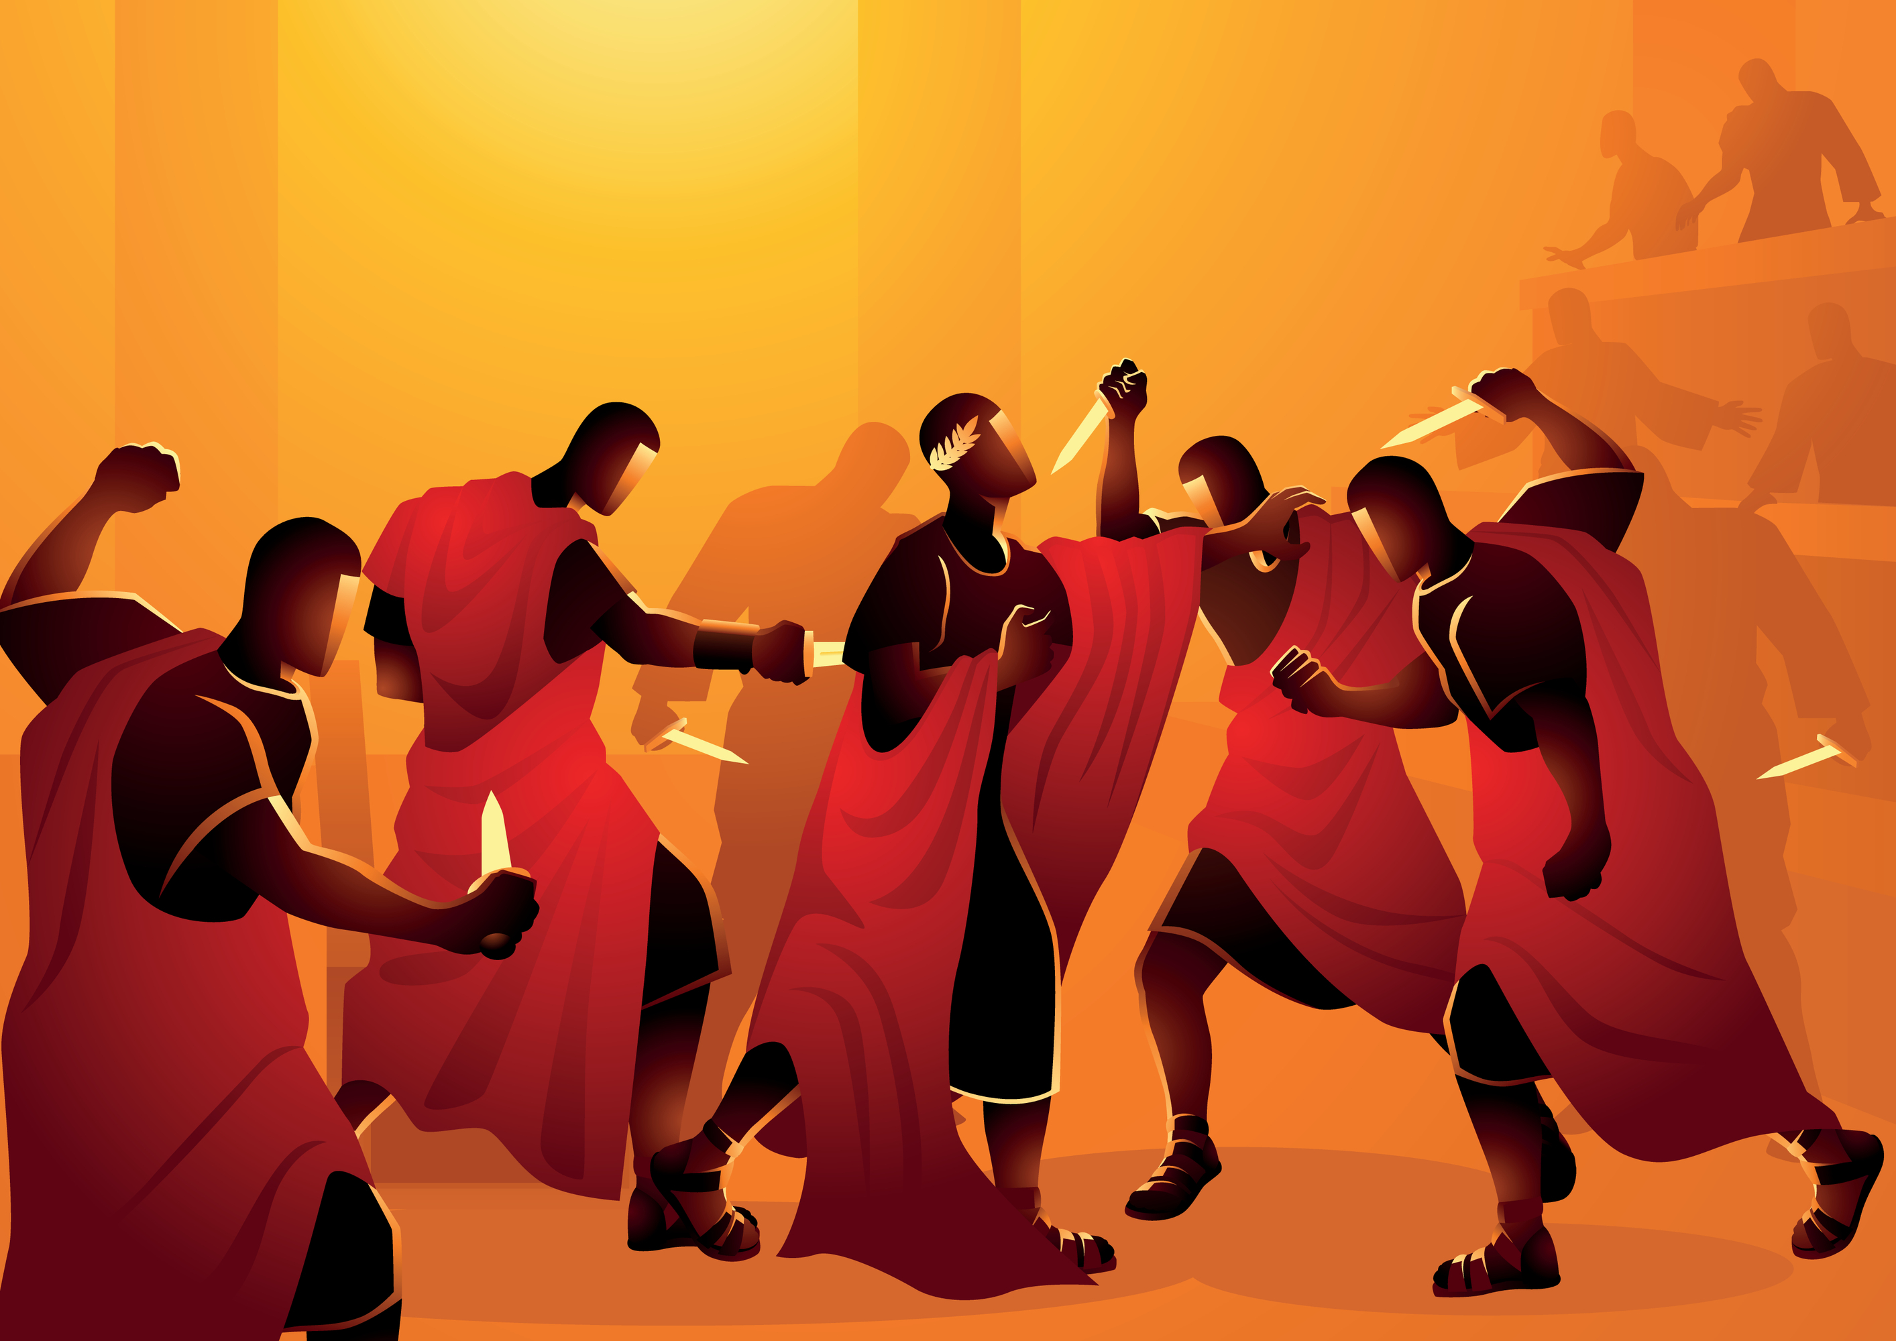
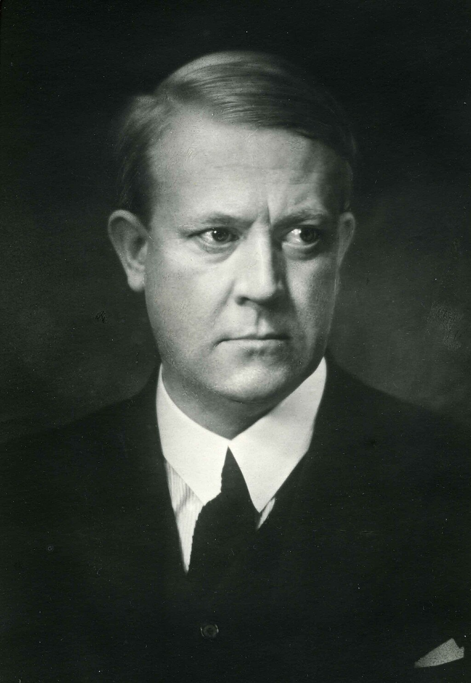
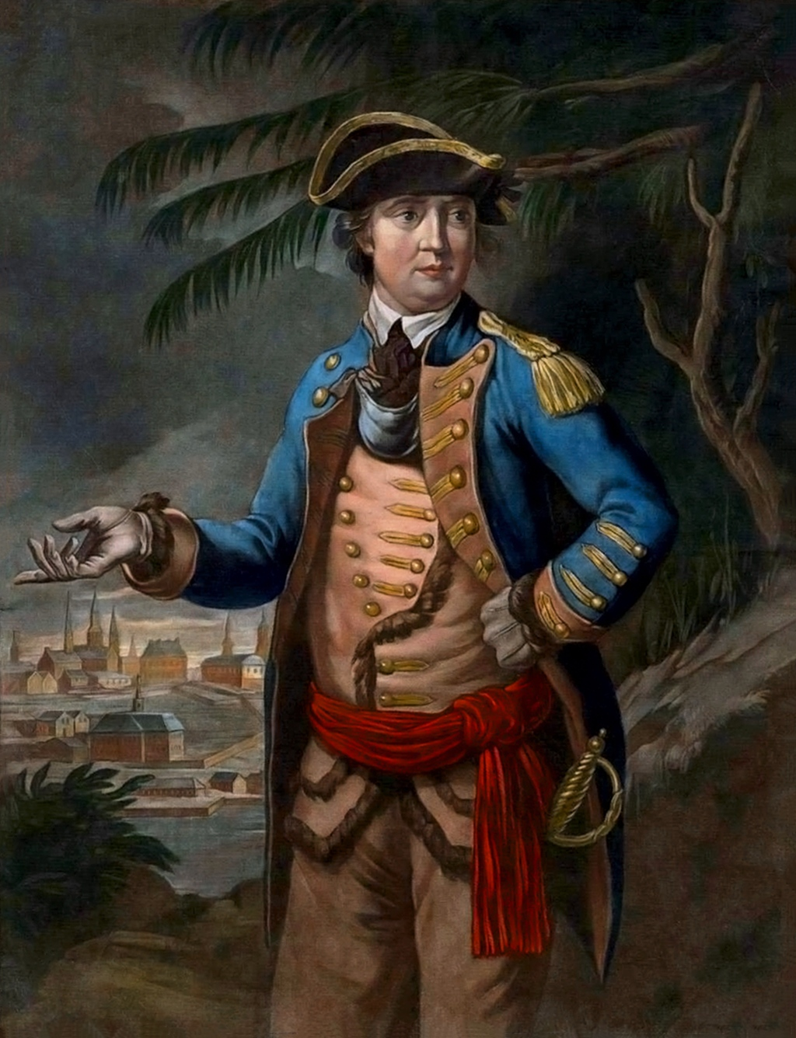
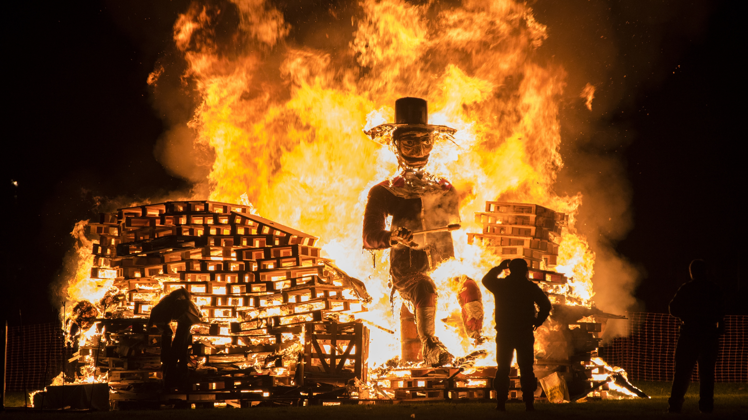
You too, Brutus?

Slide 3
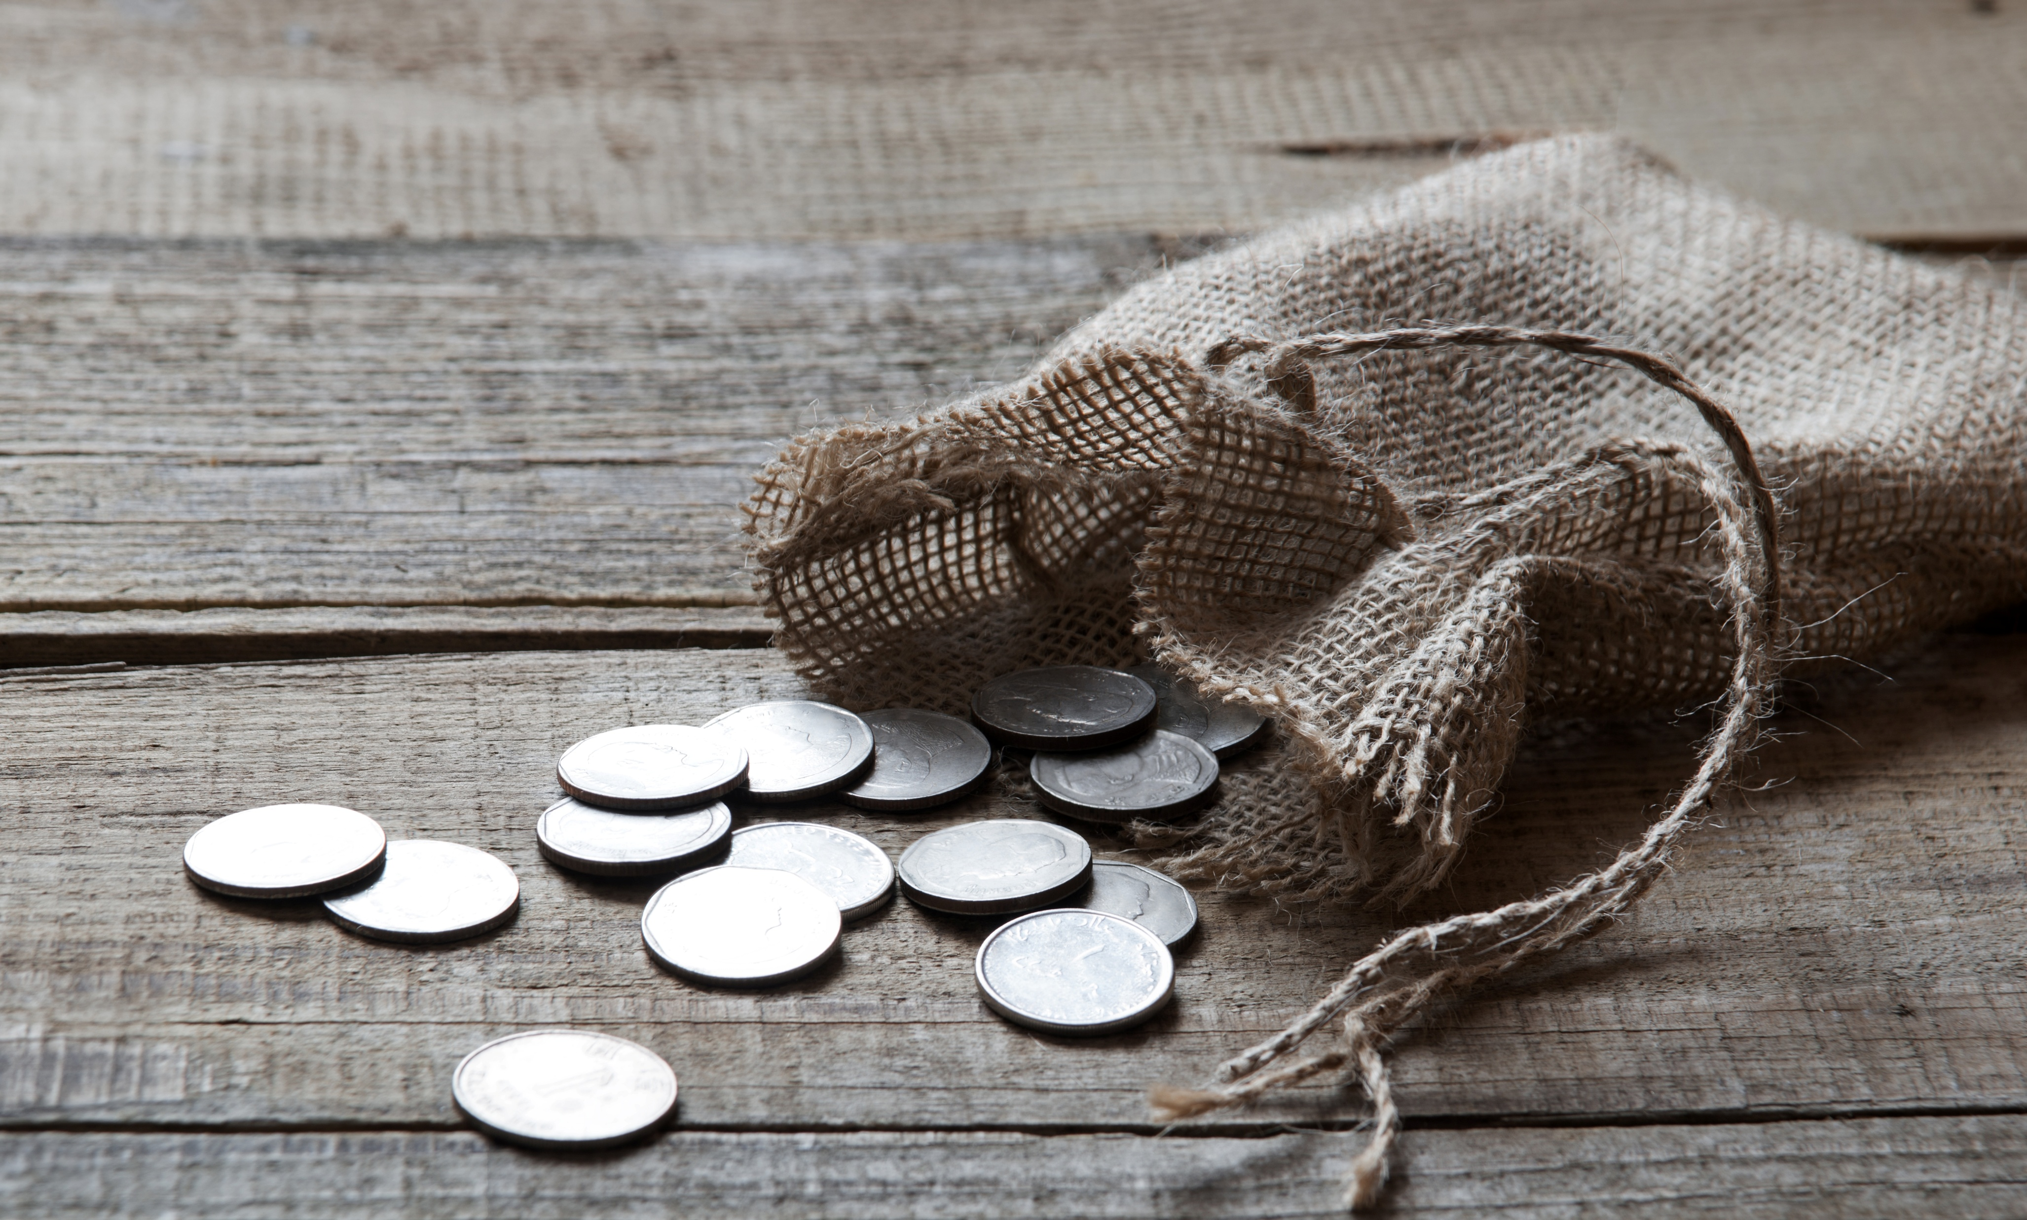

Slide 4
John 13:17
If you know these things, blessed are you if you do them.

Slide 5
Fulfilled Prophecy
Verses 18-20

Slide 6
John 13:18
I am not speaking of all of you; I know whom I have chosen. But the Scripture will be fulfilled, ‘He who ate my bread has lifted his heel against me.’

Slide 7
Matthw 26:24
The Son of Man goes as it is written of him, but woe to that man by whom the Son of Man is betrayed! It would have been better for that man if he had not been born.”

Slide 8
John 13:19-20
I am telling you this now, before it takes place, that when it does take place you may believe that I am he*. Truly, truly, I say to you, whoever receives the one I send receives me, and whoever receives me receives the one who sent me.”
*or “that I am.”

Slide 9
Opportunity to Repent
Verses 21-26

Slide 10
John 13:21-22
After saying these things, Jesus was troubled in his spirit, and testified, “Truly, truly, I say to you, one of you will betray me.” The disciples looked at one another, uncertain of whom he spoke.

Slide 11
John 13:23-25
One of his disciples, whom Jesus loved, was reclining at table at Jesus' side, so Simon Peter motioned to him to ask Jesus of whom he was speaking. So that disciple, leaning back against Jesus, said to him, “Lord, who is it?”

Slide 12
John 13:26
Jesus answered, “It is he to whom I will give this morsel of bread when I have dipped it.” So when he had dipped the morsel, he gave it to Judas, the son of Simon Iscariot.

Slide 13
Consequences
Verses 27-30

Slide 14
John 13:27-30
Then after he had taken the morsel, Satan entered into him. Jesus said to him, “What you are going to do, do quickly.” Now no one at the table knew why he said this to him. Some thought that, because Judas had the moneybag, Jesus was telling him, “Buy what we need for the feast,” or that he should give something to the poor. So, after receiving the morsel of bread, he immediately went out. And it was night.

Slide 15
Why would Judas do this?
Hoping Jesus would eliminate the consequences?
Giving Jesus one last chance to be the kind of Messiah he wanted?
Getting back at Jesus for rebuking him when he criticized Mary’s act of worship?
Gaining the acceptance of powerful people?
Straight up greed?

Slide 16
Why would Judas do this?
He valued the things of this world more highly than eternal life.
He did not trust Jesus.

Slide 17
Hebrews 10:26-28
For if we go on sinning deliberately after receiving the knowledge of the truth, there no longer remains a sacrifice for sins, but a fearful expectation of judgment, and a fury of fire that will consume the adversaries. Anyone who has set aside the law of Moses dies without mercy on the evidence of two or three witnesses.

Slide 18
Hebrews 10:29-31
How much worse punishment, do you think, will be deserved by the one who has trampled underfoot the Son of God, and has profaned the blood of the covenant by which he was sanctified, and has outraged the Spirit of grace? For we know him who said, “Vengeance is mine; I will repay.” And again, “The Lord will judge his people.” It is a fearful thing to fall into the hands of the living God.

Slide 19
Rebellious sin takes many forms
Rebellion against the value of human life (abortion, racism, prejudice, insults, euthanasia…)
Rebellion against godly self-control (drunkenness, laziness, angry outbursts…)
Rebellion against God’s principles for marriage & sexuality (premarital sex, adultery, homosexuality, divorce, pornography…)
Rebellion against Christlike love (gossip, grudges, complaining, ignoring the poor & needy…)

Slide 20
Why would we do this?
It would make me feel so happy…
Resisting temptation is so hard…
I have the right to do this…
It accomplishes something good…
They did it first…
Everyone is doing it…
It’s not hurting anybody…

Slide 21
Why would we do this?
We have decided to value something else more highly than our relationship with God.
  Pleasure
  Wealth / Leisure
  Acceptance / Popularity
  Safety
  Influence

Slide 22
Why would we do this?
We have decided to value something else more highly than our relationship with God.
We don’t trust Jesus.

Slide 23
Applications
Trust in Jesus to forgive your sins and transform your life.
Take care of any deliberate sin in your life.

Slide 24
Taking Care of Deliberate Sin
Acknowledge it as sin to God and ask his forgiveness (confession)
Ask for forgiveness from anyone you have mistreated (confession) and do what you can to make it right (restitution)
Turn away from sin (repentance)
Get help from a mature brother or sister in Christ if this is a continual struggle.

Slide 25
1 John 1:9-2:2
If we confess our sins, he is faithful and just to forgive us our sins and to cleanse us from all unrighteousness. If we say we have not sinned, we make him a liar, and his word is not in us.
My little children, I am writing these things to you so that you may not sin. But if anyone does sin, we have an advocate with the Father, Jesus Christ the righteous. He is the propitiation for our sins, and not for ours only but also for the sins of the whole world.

