Slide 1
Do Not Let Your Hearts Be Troubled
John 13:36-14:14

Slide 2
Hard Times Ahead
One of the 12 is a traitor (John 13:21)
Jesus is going away (John 13:33)
Satan is at work among them (Luke 22:31)
All the disciples will fall away (Matthew 26:31)
Peter will deny Jesus three times (John 13:38)

Slide 3
John 13:36-38
Simon Peter said to him, “Lord, where are you going?” Jesus answered him, “Where I am going you cannot follow me now, but you will follow afterward.” Peter said to him, “Lord, why can I not follow you now? I will lay down my life for you.” Jesus answered, “Will you lay down your life for me? Truly, truly, I say to you, the rooster will not crow till you have denied me three times.

Slide 4
Hard Times Ahead
One of the 12 is a traitor (John 13:21)
Jesus is going away (John 13:33)
Satan is at work among them (Luke 22:31)
All the disciples will fall away (Matthew 26:31)
Peter will deny Jesus three times (John 13:38)

Slide 5
God Is Trustworthy
Verse 1

Slide 6
John 14:1
“Let not your hearts be troubled. Believe in God; believe also in me.

Slide 7
John 14:1
“Let not your hearts be troubled. Believe in God; believe also in me.
James 2:19 – You believe that God is one; you do well. Even the demons believe—and shudder!

Slide 8
John 14:1
“Let not your hearts be troubled. Believe in God; believe also in me.
Believe: to consider something to be true and therefore worthy of one’s trust. (BDAG Lexicon)
What I know about God allows me to have confidence and be at peace as I rely on him.

Slide 9
Romans 8:31-32
What then shall we say to these things? If God is for us, who can be against us? He who did not spare his own Son but gave him up for us all, how will he not also with him graciously give us all things?

Slide 10
Romans 8:33-34
Who shall bring any charge against God's elect? It is God who justifies. Who is to condemn? Christ Jesus is the one who died—more than that, who was raised—who is at the right hand of God, who indeed is interceding for us.

Slide 11
Philippians 4:6-7
do not be anxious about anything, but in everything by prayer and supplication with thanksgiving let your requests be made known to God. And the peace of God, which surpasses all understanding, will guard your hearts and your minds in Christ Jesus.

Slide 12
Philippians 4:8
Finally, brothers, whatever is true, whatever is honorable, whatever is just, whatever is pure, whatever is lovely, whatever is commendable, if there is any excellence, if there is anything worthy of praise, think about these things.

Slide 13
Anti-Philippians 4:8
Finally, brothers, whatever is false, whatever is dishonorable, whatever is unjust, whatever is filthy, whatever causes outrage, whatever is shameful, if there is any deficiency, if there is something worthy of condemnation…

Slide 14
Philippians 4:9
What you have learned and received and heard and seen in me—practice these things, and the God of peace will be with you.

Slide 15
Heaven Is Our Home
Verses 2-7

Slide 16
John 14:3-4
In my Father's house are many rooms*. If it were not so, would I have told you that I go to prepare a place for you? And if I go and prepare a place for you, I will come again and will take you to myself, that where I am you may be also.
*or dwellings

Slide 17
Revelation 21:3-4
And I heard a loud voice from the throne saying, “Behold, the dwelling place of God is with man. He will dwell with them, and they will be his people, and God himself will be with them as their God. He will wipe away every tear from their eyes, and death shall be no more, neither shall there be mourning, nor crying, nor pain anymore, for the former things have passed away.”

Slide 18
2 Corinthians 4:16-18
So we do not lose heart. Though our outer self is wasting away, our inner self is being renewed day by day. For this light momentary affliction is preparing for us an eternal weight of glory beyond all comparison, as we look not to the things that are seen but to the things that are unseen. For the things that are seen are transient, but the things that are unseen are eternal.

Slide 19
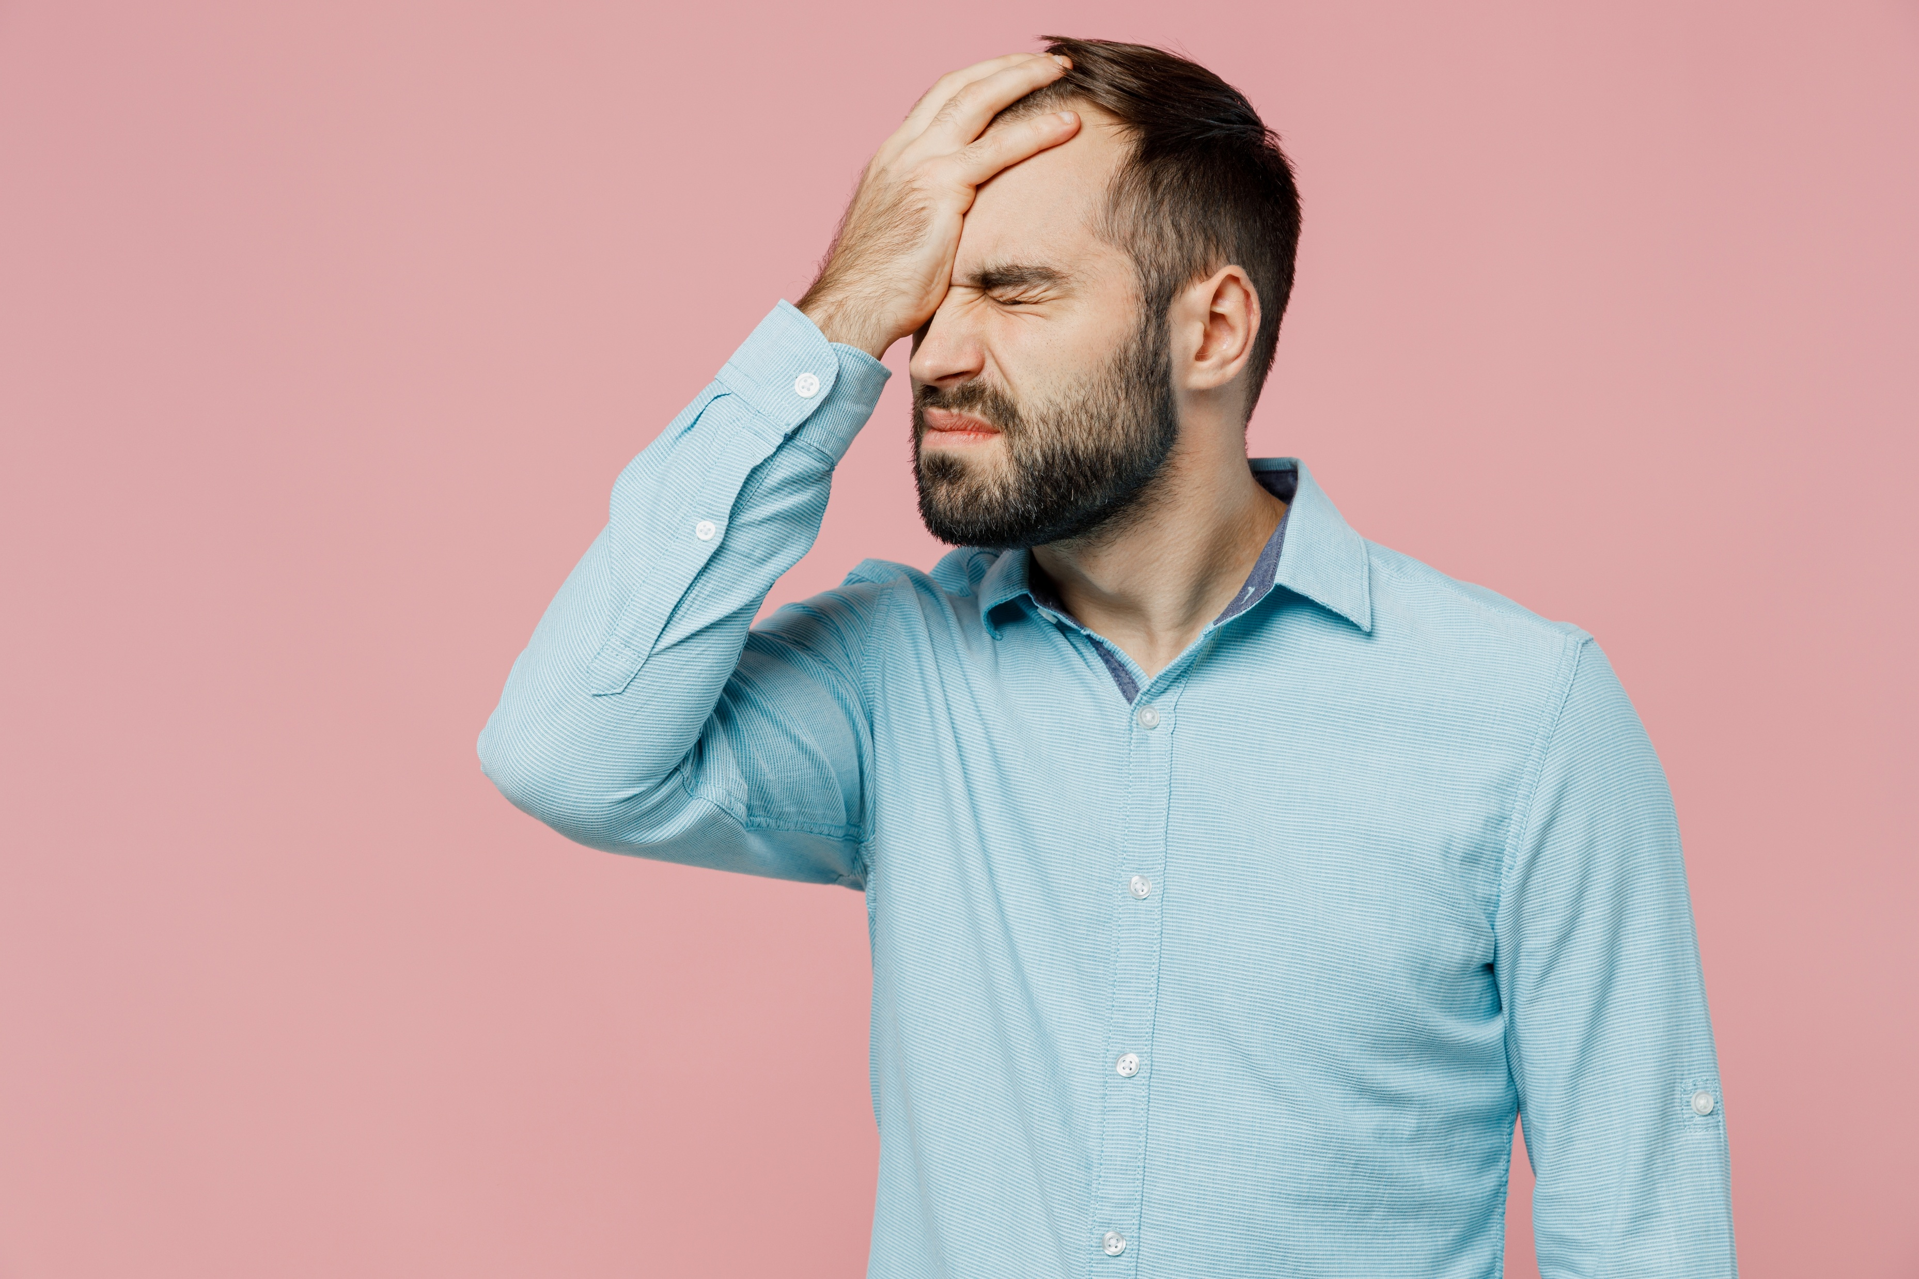
John 14:4-5
And you know the way to where I am going.” Thomas said to him, “Lord, we do not know where you are going. How can we know the way?”

Slide 20
John 14:6-7
Jesus said to him, “I am the way, and the truth, and the life. No one comes to the Father except through me. If you had known me, you would have known my Father also. From now on you do know him and have seen him.”

Slide 21
1 John 5:10-13
Whoever believes in the Son of God has the testimony in himself. Whoever does not believe God has made him a liar, because he has not believed in the testimony that God has borne concerning his Son. And this is the testimony, that God gave us eternal life, and this life is in his Son. Whoever has the Son has life; whoever does not have the Son of God does not have life.

Slide 22
God Has Revealed His Character
Verses 8-11

Slide 23

John 14:8
Philip said to him, “Lord, show us the Father, and it is enough for us.”

Slide 24
John 14:9a
Jesus said to him, “Have I been with you so long, and you still do not know me, Philip?

Slide 25
John 14:9b-11
Whoever has seen me has seen the Father. How can you say, ‘Show us the Father’? Do you not believe that I am in the Father and the Father is in me? The words that I say to you I do not speak on my own authority, but the Father who dwells in me does his works. Believe me that I am in the Father and the Father is in me, or else believe on account of the works themselves.

Slide 26
Hebrews 1:1-2
Long ago, at many times and in many ways, God spoke to our fathers by the prophets, but in these last days he has spoken to us by his Son, whom he appointed the heir of all things, through whom also he created the world.

Slide 27
Hebrews 1:3
He is the radiance of the glory of God and the exact imprint of his nature, and he upholds the universe by the word of his power. After making purification for sins, he sat down at the right hand of the Majesty on high,

Slide 28
We Have Purpose & Power
Verses 12-14

Slide 29
John 14:12-14
“Truly, truly, I say to you, whoever believes in me will also do the works that I do; and greater works than these will he do, because I am going to the Father. Whatever you ask in my name, this I will do, that the Father may be glorified in the Son. If you ask me anything in my name, I will do it.

Slide 30
Eternal Impact
“…remember that the dullest and most uninteresting person you talk to may one day be a creature which, if you saw it now, you would be strongly tempted to worship, or else a horror and a corruption such as you now meet, if at all, only in a nightmare
All day long we are, in some degree, helping each other to one or other of these destinations…”

Slide 31
“There are no ordinary people. You have never talked to a mere mortal….But it is immortals whom we joke with, work with, marry, snub, and exploit—immortal horrors or everlasting splendors.”
– C. S. Lewis (The Weight of Glory)

Slide 32
John 14:12-14
“Truly, truly, I say to you, whoever believes in me will also do the works that I do; and greater works than these will he do, because I am going to the Father. Whatever you ask in my name, this I will do, that the Father may be glorified in the Son. If you ask me anything in my name, I will do it.

Slide 33
Hebrews 4:16
Let us then with confidence draw near to the throne of grace, that we may receive mercy and find grace to help in time of need.

Slide 34
Do not let your hearts be troubled
God is trustworthy.
Heaven is our home.
God has revealed his loving character.
We have purpose & power.

