Slide 1
The True Vine
John 15:1-17

Slide 2
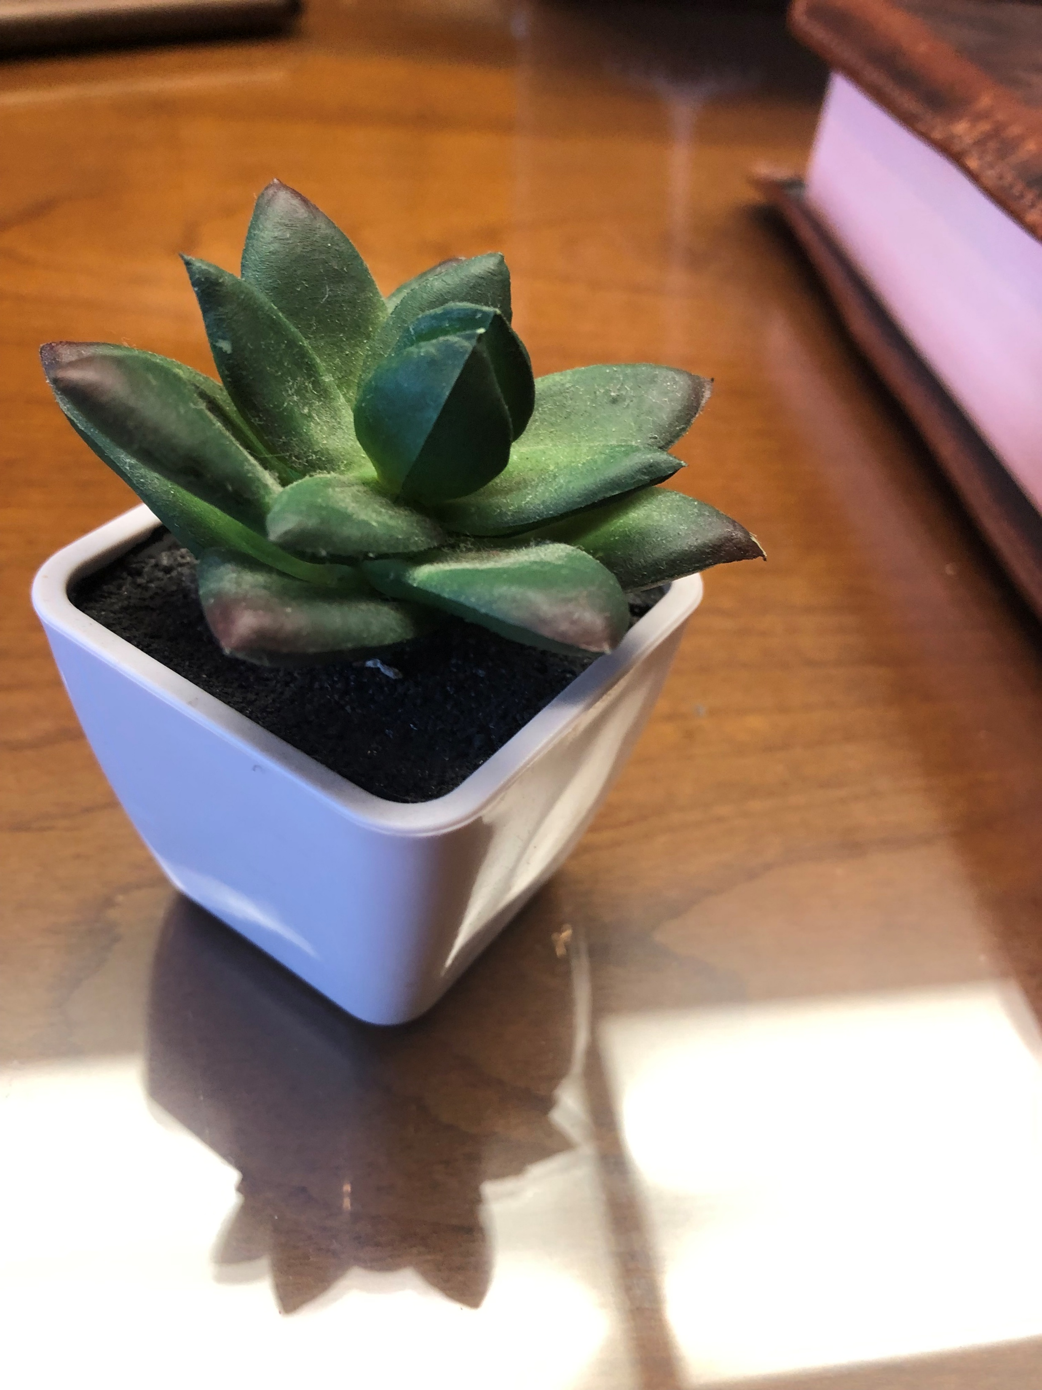

Slide 3
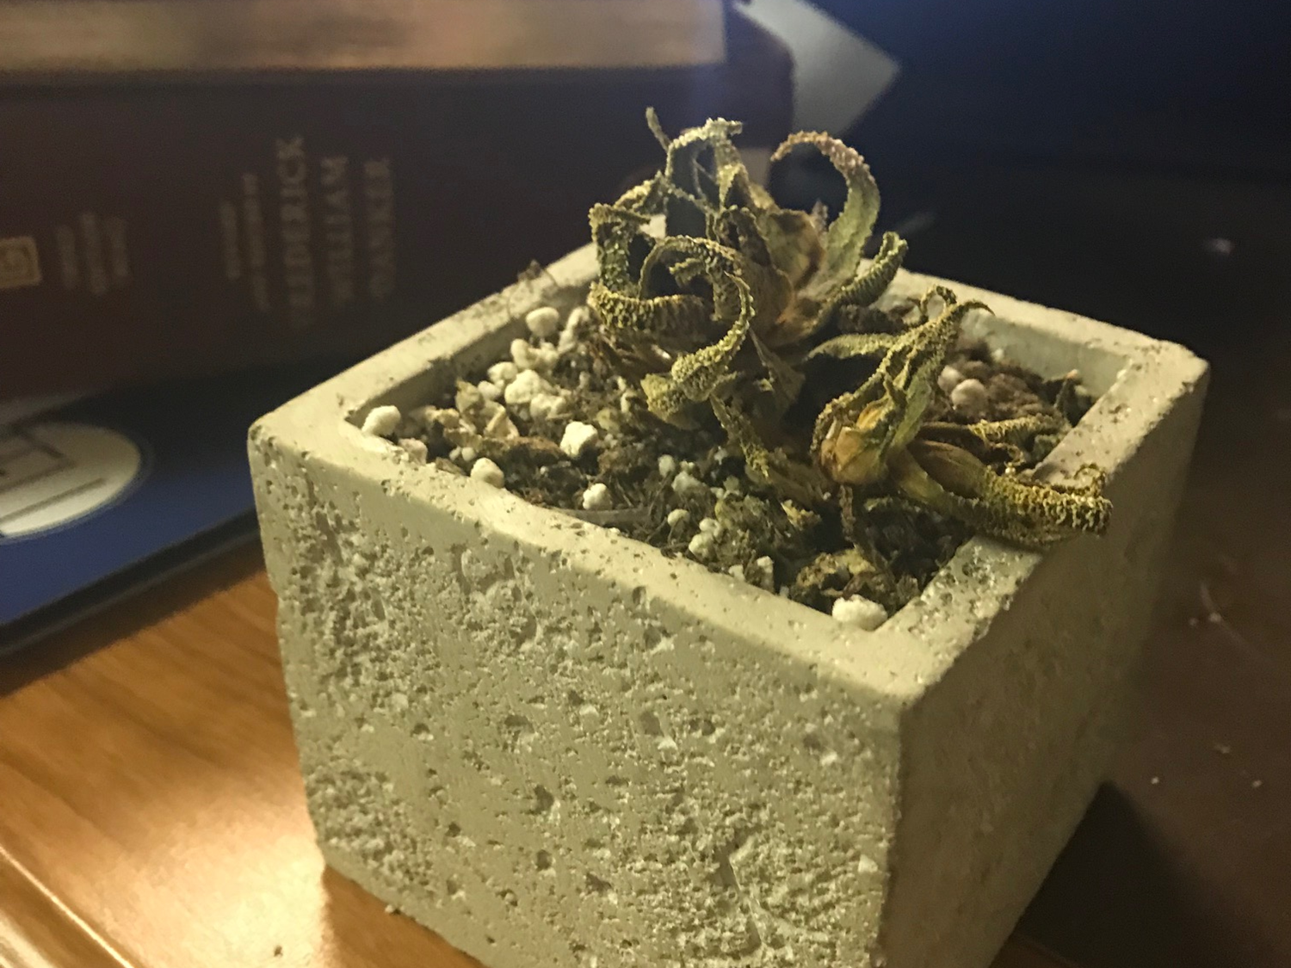

Slide 4
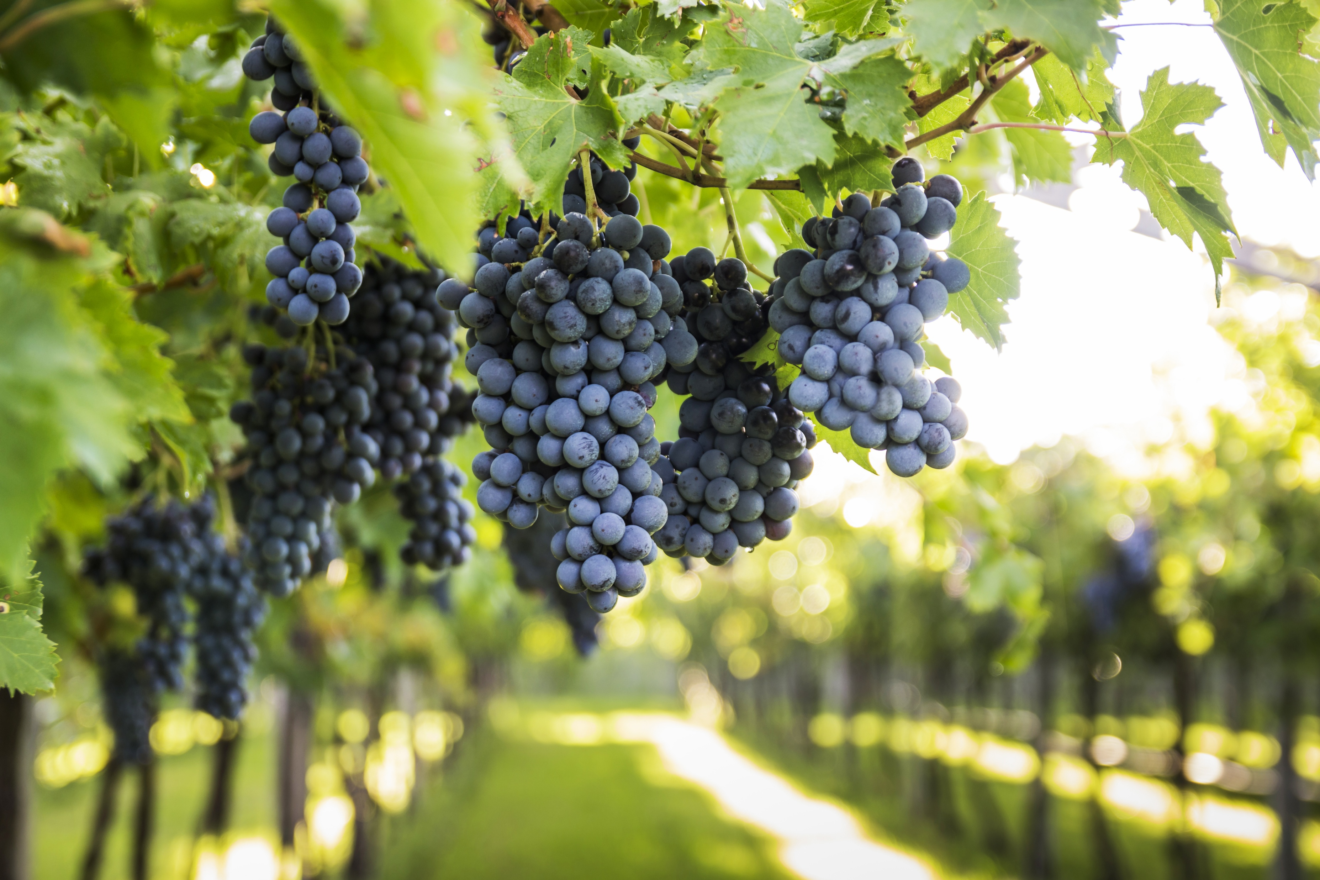

Slide 5
Abiding in Jesus
Verses 1-11

Slide 6
The Father’s Role
Verses 1-2

Slide 7
John 15:1
“I am the true vine, and my Father is the vinedresser.

Slide 8
Jesus: The Only Source of True Life
14:14 – but whoever drinks of the water that I will give him will never be thirsty again. The water that I will give him will become in him a spring of water welling up to eternal life.”
6:35 – Jesus said to them, “I am the bread of life; whoever comes to me shall not hunger, and whoever believes in me shall never thirst.
10:10– I came that they may have life and have it abundantly.

Slide 9
John 15:1
“I am the true vine, and my Father is the vinedresser.

Slide 10
John 15:1-2a
“I am the true vine, and my Father is the vinedresser. Every branch in me that does not bear fruit he takes away…

Slide 11
1 John 2:19
They went out from us, but they were not of us; for if they had been of us, they would have continued with us. But they went out, that it might become plain that they all are not of us.

Slide 12
Matthew 7:23
And then will I declare to them, ‘I never knew you; depart from me, you workers of lawlessness.’

Slide 13
John 15:1-2
“I am the true vine, and my Father is the vinedresser. Every branch in me that does not bear fruit he takes away, and every branch that does bear fruit he prunes, that it may bear more fruit.

Slide 14
Psalm 32:3-4
For when I kept silent, my bones wasted away
through my groaning all day long.
For day and night your hand was heavy upon me;
my strength was dried up as by the heat of summer.

Slide 15
Hebrews 12:6
For the Lord disciplines the one he loves, and chastises every son whom he receives.

Slide 16
James 1:2-4
Count it all joy, my brothers, when you meet trials of various kinds, for you know that the testing of your faith produces steadfastness. And let steadfastness have its full effect, that you may be perfect and complete, lacking in nothing.

Slide 17
Our Reliance
Verses 3-8

Slide 18
John 15:3
Already you are clean because of the word that I have spoken to you.

Slide 19
John 15:4-5
Abide* in me, and I in you. As the branch cannot bear fruit by itself, unless it abides in the vine, neither can you, unless you abide in me. I am the vine; you are the branches. Whoever abides in me and I in him, he it is that bears much fruit, for apart from me you can do nothing.
*Remain

Slide 20
John 15:6
If anyone does not abide in me, he is thrown away like a branch and withers; and the branches are gathered, thrown into the fire, and burned.

Slide 21
John 15:7-8
If you abide in me, and my words abide in you, ask whatever you wish, and it will be done for you. By this my Father is glorified, that you bear much fruit and so prove to be my disciples.

Slide 22
James 1:5
If any of you lacks wisdom, let him ask God, who gives generously to all without reproach, and it will be given him.

Slide 23
Ephesians 6:18-19
praying at all times in the Spirit, with all prayer and supplication. To that end, keep alert with all perseverance, making supplication for all the saints, and also for me, that words may be given to me in opening my mouth boldly to proclaim the mystery of the gospel,

Slide 24
Ephesians 1:16-19
I pray that out of his glorious riches he may strengthen you with power through his Spirit in your inner being, so that Christ may dwell in your hearts through faith. And I pray that you, being rooted and established in love…

Slide 25
Ephesians 1:16-19
…may have power, together with all the Lord’s holy people, to grasp how wide and long and high and deep is the love of Christ, and to know this love that surpasses knowledge—that you may be filled to the measure of all the fullness of God.

Slide 26
The Results
Verses 9-11

Slide 27
John 15:9-10
As the Father has loved me, so have I loved you. Abide in my love. If you keep my commandments, you will abide in my love, just as I have kept my Father's commandments and abide in his love.

Slide 28
1 Peter 1:3-5
Blessed be the God and Father of our Lord Jesus Christ! According to his great mercy, he has caused us to be born again to a living hope through the resurrection of Jesus Christ from the dead, to an inheritance that is imperishable, undefiled, and unfading, kept in heaven for you, who by God's power are being guarded through faith for a salvation ready to be revealed in the last time

Slide 29
John 15:9-10
As the Father has loved me, so have I loved you. Abide in my love. If you keep my commandments, you will abide in my love, just as I have kept my Father's commandments and abide in his love.

Slide 30
John 15:11
These things I have spoken to you, that my joy may be in you, and that your joy may be full.

Slide 31
Loving Relationship
Verses 12-17

Slide 32
His Command
Verses 12-13

Slide 33
John 15:12
“This is my commandment, that you love one another as I have loved you.

Slide 34
John 15:13
Greater love has no one than this, that someone lay down his life for his friends.

Slide 35
Our Relationship
Verses 14-17

Slide 36
John 15:14-15
You are my friends if you do what I command you. No longer do I call you servants, for the servant does not know what his master is doing; but I have called you friends, for all that I have heard from my Father I have made known to you.

Slide 37
John 15:16
You did not choose me, but I chose you and appointed you that you should go and bear fruit and that your fruit should abide, so that whatever you ask the Father in my name, he may give it to you.

Slide 38
Ephesians 1:3-5
Blessed be the God and Father of our Lord Jesus Christ, who has blessed us in Christ with every spiritual blessing in the heavenly places, even as he chose us in him before the foundation of the world, that we should be holy and blameless before him. In love he predestined us for adoption to himself as sons through Jesus Christ, according to the purpose of his will, (See also John 6:38-45)

Slide 39
John 15:16
You did not choose me, but I chose you and appointed you that you should go and bear fruit and that your fruit should abide, so that whatever you ask the Father in my name, he may give it to you.

Slide 40
Galatians 5:22-23
But the fruit of the Spirit is love, joy, peace, patience, kindness, goodness, faithfulness, gentleness, self-control; against such things there is no law.

Slide 41
Philippians 1:9-11
And it is my prayer that your love may abound more and more, with knowledge and all discernment, so that you may approve what is excellent, and so be pure and blameless for the day of Christ, filled with the fruit of righteousness that comes through Jesus Christ, to the glory and praise of God.

Slide 42
Hebrews 13:15
Through him then let us continually offer up a sacrifice of praise to God, that is, the fruit of lips that acknowledge his name.

Slide 43
Romans 1:13
I do not want you to be unaware, brothers, that I have often intended to come to you (but thus far have been prevented), in order that I may reap some harvest among you as well as among the rest of the Gentiles.

Slide 44
John 15:17
These things I command you, so that you will love one another.

Slide 45
Applications
Pray for the things that will make you truly fruitful:
  Wisdom in difficult situations
  Boldness & opportunity to witness
  Means & opportunity to help others
As you interact with others, keep in mind Jesus’ primary command: Love one another

Slide 46
Put these 2 verses where you will see them:
John 15:12 – This is my commandment, that you love one another as I have loved you.
Matthew 7:12 – So whatever you wish that others would do to you, do also to them, for this is the Law and the Prophets.

