Slide 1
Law & Grace

Slide 2
“Cherry Picking”?
No shellfish (Leviticus 11:9-12)
No mixed-fabric clothing (Leviticus 19:19)
No homosexuality (Leviticus 18:22)
No tattoos (Leviticus 19:28)
No work on the Sabbath (Leviticus 23:3)

Slide 3
Various approaches
“The Old Testament is essentially worthless.” (Marcion the Heretic, Gnosticism)
“Pretty much all the OT Laws should be obeyed today.” (Pharisees, Judaizers)
“Only the moral laws are for today, not the ceremonial or civic ones.”

Slide 4
What is the Law?

Slide 5
Content
The commandments given to Israel in Exodus-Deuteronomy
The conditions of the Mosaic Covenant (Exodus 20ff, Deuteronomy 28-30)

Slide 6
Deuteronomy 28:1
And if you faithfully obey the voice of the Lord your God, being careful to do all his commandments that I command you today, the Lord your God will set you high above all the nations of the earth.

Slide 7
Deuteronomy 28:15
But if you will not obey the voice of the Lord your God or be careful to do all his commandments and his statutes that I command you today, then all these curses shall come upon you and overtake you.

Slide 8
Deuteronomy 30:1-2
“And when all these things come upon you, the blessing and the curse, which I have set before you, and you call them to mind among all the nations where the Lord your God has driven you, and return to the Lord your God, you and your children, and obey his voice in all that I command you today, with all your heart and with all your soul,…

Slide 9
Deuteronomy 30:3
then the Lord your God will restore your fortunes and have mercy on you, and he will gather you again from all the peoples where the Lord your God has scattered you.

Slide 10
What purpose(s) did the Law have?

Slide 11
Leviticus 20:26
You shall be holy to me, for I the Lord am holy and have separated you from the peoples, that you should be mine.

Slide 12
Romans 3:19-20
Now we know that whatever the law says it speaks to those who are under the law, so that every mouth may be stopped, and the whole world may be held accountable to God. For by works of the law no human being will be justified in his sight, since through the law comes knowledge of sin.

Slide 13
Romans 3:21-24
But now the righteousness of God has been manifested apart from the law, although the Law and the Prophets bear witness to it— the righteousness of God through faith in Jesus Christ for all who believe. For there is no distinction: for all have sinned and fall short of the glory of God, and are justified by his grace as a gift, through the redemption that is in Christ Jesus,

Slide 14
Some effects of individual laws
Defining what is morally right & wrong
Providing object lessons (types) of Christ
Protecting people from each other
Encouraging good health
Running the national government
Making Israel distinct
Avoiding pagan worship practices

Slide 15
What does the New Testament say about the Law?

Slide 16
Matthew 5:17
Do not think that I have come to abolish the Law or the Prophets; I have not come to abolish them but to fulfill them.

Slide 17
Acts 5:7-9
And after there had been much debate, Peter stood up and said to them, “Brothers, you know that in the early days God made a choice among you, that by my mouth the Gentiles should hear the word of the gospel and believe. And God, who knows the heart, bore witness to them, by giving them the Holy Spirit just as he did to us, and he made no distinction between us and them, having cleansed their hearts by faith.

Slide 18
Acts 5:10-11
Now, therefore, why are you putting God to the test by placing a yoke on the neck of the disciples that neither our fathers nor we have been able to bear? But we believe that we will be saved through the grace of the Lord Jesus, just as they will.”

Slide 19
Colossians 3:16-17
Therefore let no one pass judgment on you in questions of food and drink, or with regard to a festival or a new moon or a Sabbath. These are a shadow of the things to come, but the substance belongs to Christ.

Slide 20
Galatians 3:10-12
For all who rely on works of the law are under a curse; for it is written, “Cursed be everyone who does not abide by all things written in the Book of the Law, and do them.” Now it is evident that no one is justified before God by the law, for “The righteous shall live by faith.” But the law is not of faith, rather “The one who does them shall live by them.”

Slide 21
Galatians 3:13-14
Christ redeemed us from the curse of the law by becoming a curse for us—for it is written, “Cursed is everyone who is hanged on a tree”— so that in Christ Jesus the blessing of Abraham might come to the Gentiles, so that we might receive the promised Spirit through faith.

Slide 22
Galatians 5:1-4
For freedom Christ has set us free; stand firm therefore, and do not submit again to a yoke of slavery. Look: I, Paul, say to you that if you accept circumcision, Christ will be of no advantage to you. I testify again to every man who accepts circumcision that he is obligated to keep the whole law. You are severed from Christ, you who would be justified by the law; you have fallen away from grace.

Slide 23
Galatians 3:23-25
Now before faith came, we were held captive under the law, imprisoned until the coming faith would be revealed. So then, the law was our guardian until Christ came, in order that we might be justified by faith. But now that faith has come, we are no longer under a guardian,

Slide 24
How do we live holy lives?

Slide 25
Matthew 22:36-40
“Teacher, which is the great commandment in the Law?” And he said to him, “You shall love the Lord your God with all your heart and with all your soul and with all your mind. This is the great and first commandment. And a second is like it: You shall love your neighbor as yourself. On these two commandments depend all the Law and the Prophets.”

Slide 26
Romans 13:8-10
Owe no one anything, except to love each other, for the one who loves another has fulfilled the law. For the commandments, “You shall not commit adultery, You shall not murder, You shall not steal, You shall not covet,” and any other commandment, are summed up in this word: “You shall love your neighbor as yourself.” Love does no wrong to a neighbor; therefore love is the fulfilling of the law.

Slide 27
Romans 12:1-2
I appeal to you therefore, brothers, by the mercies of God, to present your bodies as a living sacrifice, holy and acceptable to God, which is your spiritual worship. Do not be conformed to this world, but be transformed by the renewal of your mind, that by testing you may discern what is the will of God, what is good and acceptable and perfect.

Slide 28
Galatians 5:22-25
But the fruit of the Spirit is love, joy, peace, patience, kindness, goodness, faithfulness, gentleness, self-control; against such things there is no law. And those who belong to Christ Jesus have crucified the flesh with its passions and desires. If we live by the Spirit, let us also keep in step with the Spirit.

Slide 29
Matthew 5:16
In the same way, let your light shine before others, so that they may see your good works and give glory to your Father who is in heaven.

Slide 30
What is the use of the Law today?

Slide 31
It reveals God’s unchanging character
Malachi 3:6 – For I the Lord do not change; therefore you, O children of Jacob, are not consumed.
Hebrews 13:8 – Jesus Christ is the same yesterday and today and forever.

Slide 32
It reveals our sinfulness & need of a Savior
From Matthew 5:21-48
vv. 21-26 – Hatred/Insults = Murder
vv. 27-32 – Lustful looks/fantasizing/divorce & remarriage = Adultery
vv. 33-37 – All speech (not just promises & oaths) must be sincere and not deceptive
vv. 38-48 – Love of neighbor includes
non-retaliation when wronged & love of enemies

Slide 33
Matthew 5:3
Blessed are the poor in spirit, for theirs is the kingdom of heaven.

Slide 34

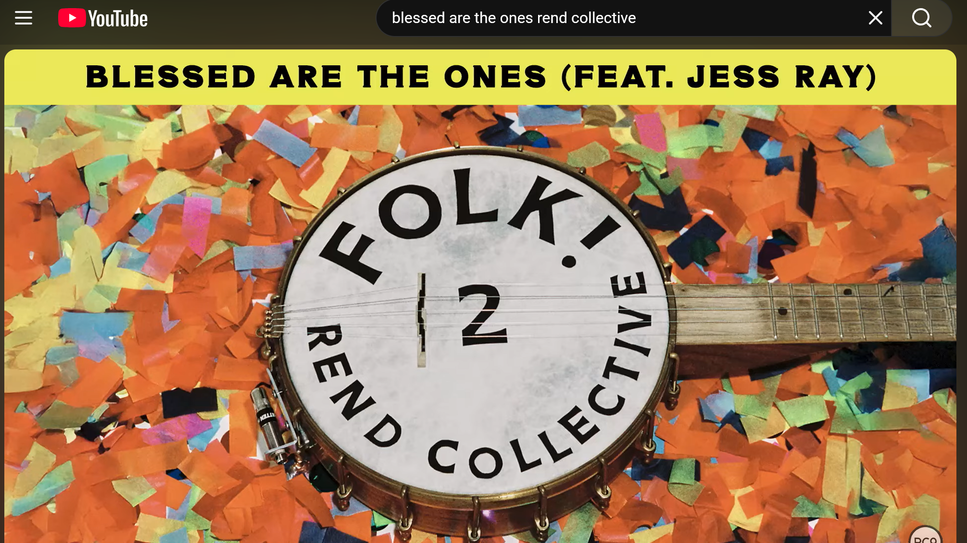

Slide 35
Applications
Trust Jesus to forgive your sins and transform your life – throw yourself on God’s mercy.
Handle God’s Word responsibly
Keep in step with the Holy Spirit (Galatians 5)

