Slide 1
The World Hates You
John 15:18-16:4

Slide 2




Slide 3
The World Hates You
John 15:18-16:4

Slide 4

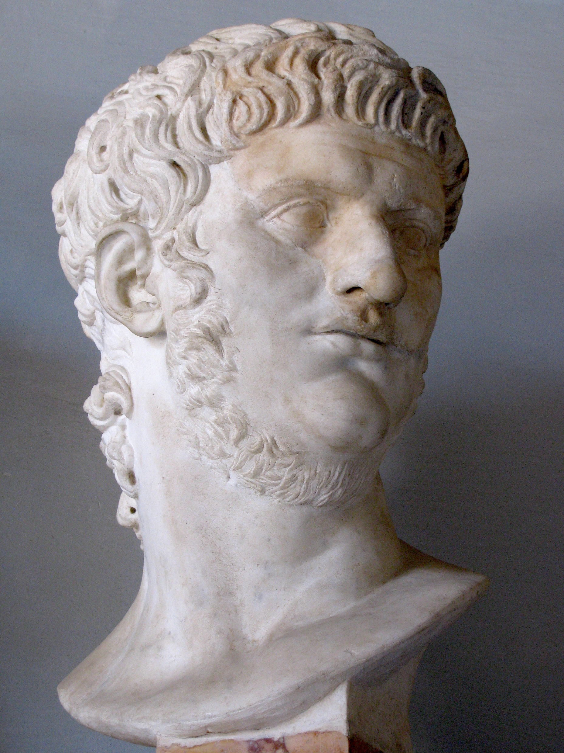
Tacitus describes persecution by Emperor Nero (~64 AD)

Slide 5
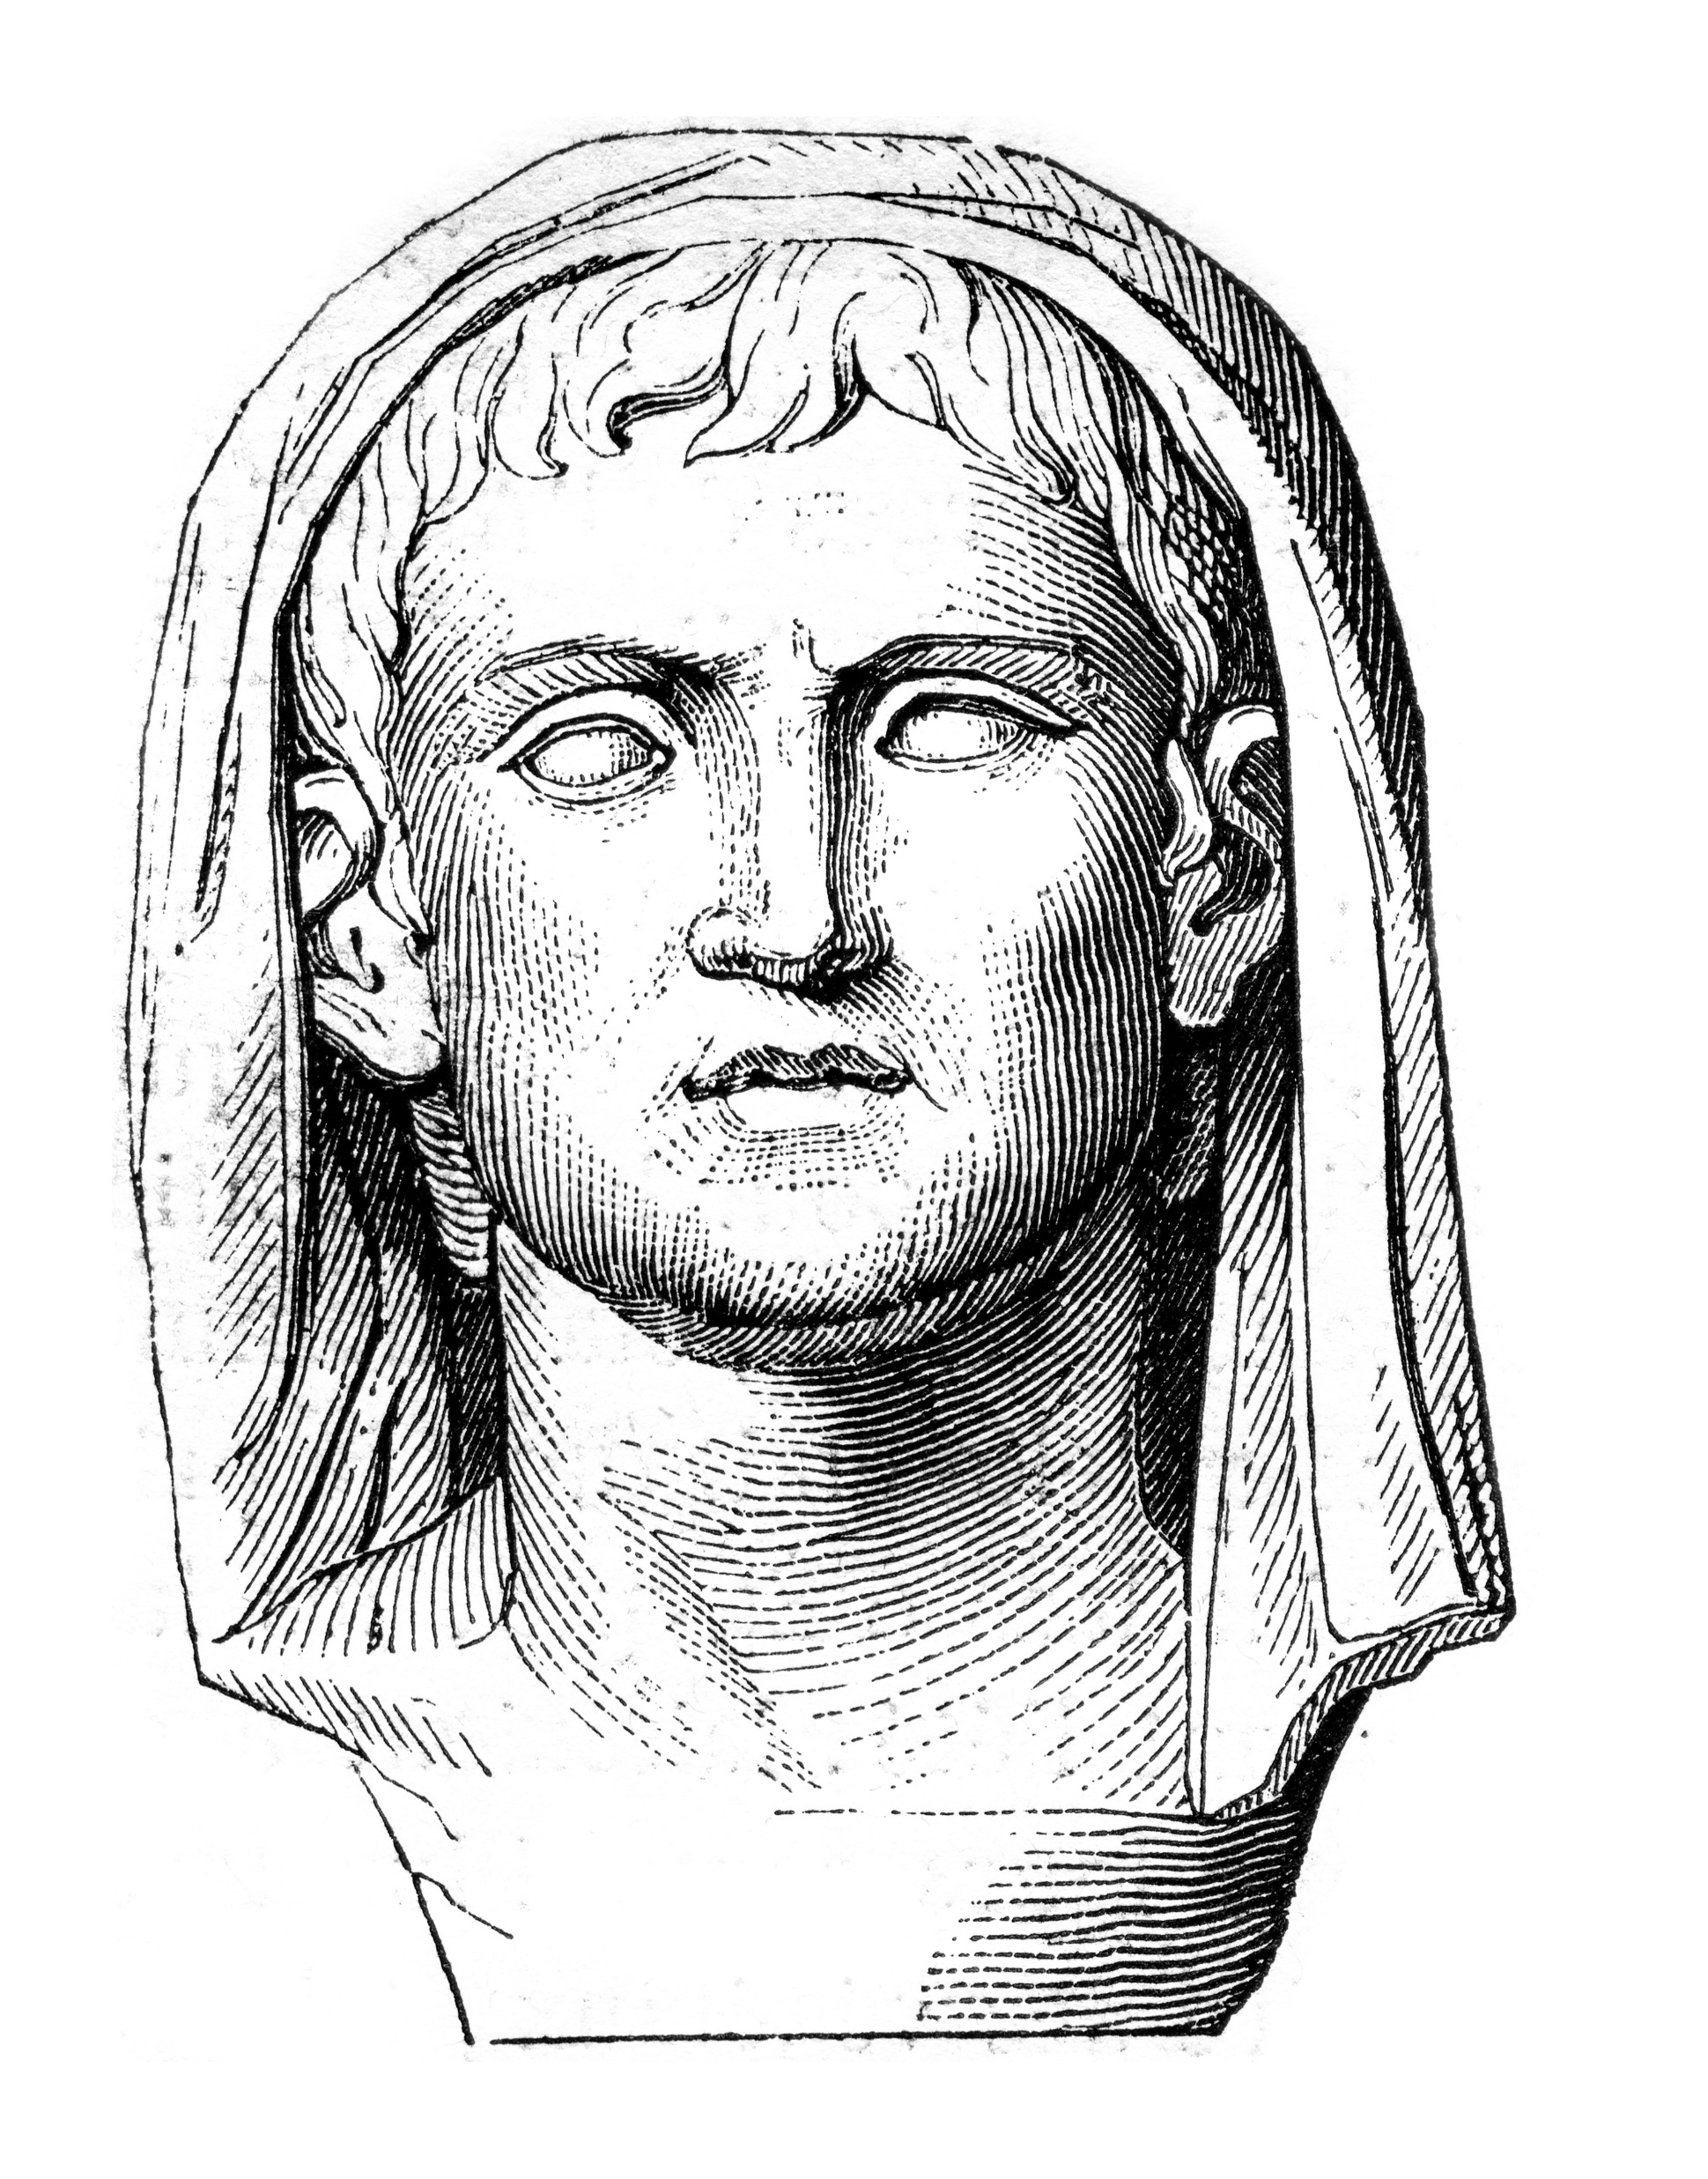
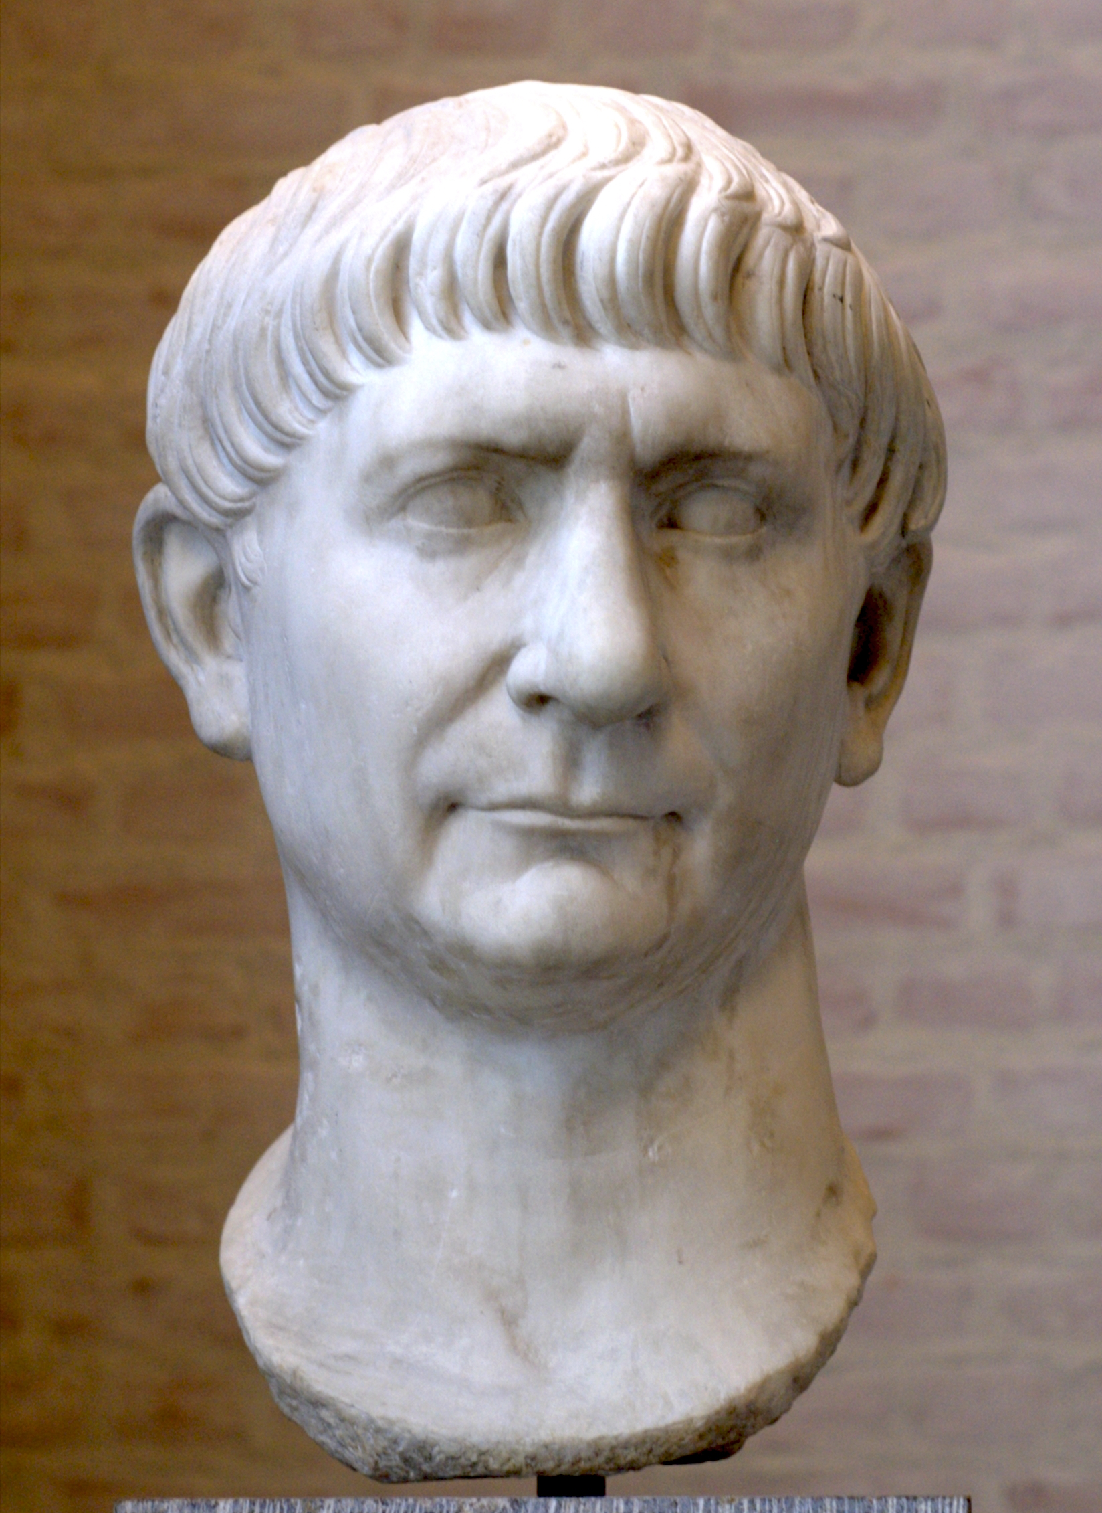
Magistrate Pliny the Younger to Emperor Trajan
(112 AD)

Slide 6
The Expectation of Hatred
Verses 18-20

Slide 7
John 15:18-19
“If the world hates you, know that it has hated me before it hated you. If you were of the world, the world would love you as its own; but because you are not of the world, but I chose you out of the world, therefore the world hates you.

Slide 8
The World
The value system corrupted by sin and influenced by Satan
How the average persons thinks & acts and expects others to think & act
Society that has chosen to pursue something other than God

Slide 9
1 John 2:16
For all that is in the world—the desires of the flesh and the desires of the eyes and pride of life*—is not from the Father but is from the world.
*or possessions

Slide 10
Demonstrations of Hatred
Condescension & Contempt
Name-calling & False Accusations
Legal Opposition
Violent Persecution

Slide 11
John 15:18-19
“If the world hates you, know that it has hated me before it hated you. If you were of the world, the world would love you as its own; but because you are not of the world, but I chose you out of the world, therefore the world hates you.

Slide 12
John 15:20
Remember the word that I said to you: ‘A servant is not greater than his master.’ If they persecuted me, they will also persecute you. If they kept my word, they will also keep yours.

Slide 13
The Reason for Hatred
Verses 21-25

Slide 14
John 15:21
But all these things they will do to you on account of my name, because they do not know him who sent me.

Slide 15
John 15:22-24
If I had not come and spoken to them, they would not have been guilty of sin, but now they have no excuse for their sin. Whoever hates me hates my Father also. If I had not done among them the works that no one else did, they would not be guilty of sin, but now they have seen and hated both me and my Father.

Slide 16
1 Corinthians 6:9-10
Or do you not know that the unrighteous will not inherit the kingdom of God? Do not be deceived: neither the sexually immoral, nor idolaters, nor adulterers, nor men who practice homosexuality, nor thieves, nor the greedy, nor drunkards, nor revilers, nor swindlers will inherit the kingdom of God.

Slide 17
1 Corinthians 6:9-10
Or do you not know that the unrighteous will not inherit the kingdom of God? Do not be deceived: neither the sexually immoral, nor idolaters, nor adulterers, nor men who practice homosexuality, nor thieves, nor the greedy, nor drunkards, nor revilers, nor swindlers will inherit the kingdom of God.

Slide 18
1 Corinthians 6:9-10
Or do you not know that the unrighteous will not inherit the kingdom of God? Do not be deceived: neither the sexually immoral, nor idolaters, nor adulterers, nor men who practice homosexuality, nor thieves, nor the greedy, nor drunkards, nor revilers, nor swindlers will inherit the kingdom of God.

Slide 19
1 Corinthians 6:9-10
Or do you not know that the unrighteous will not inherit the kingdom of God? Do not be deceived: neither the sexually immoral, nor idolaters, nor adulterers, nor men who practice homosexuality, nor thieves, nor the greedy, nor drunkards, nor revilers, nor swindlers will inherit the kingdom of God.

Slide 20
1 Corinthians 6:9-10
Or do you not know that the unrighteous will not inherit the kingdom of God? Do not be deceived: neither the sexually immoral, nor idolaters, nor adulterers, nor men who practice homosexuality, nor thieves, nor the greedy, nor drunkards, nor revilers, nor swindlers will inherit the kingdom of God.

Slide 21
1 Corinthians 6:9-10
Or do you not know that the unrighteous will not inherit the kingdom of God? Do not be deceived: neither the sexually immoral, nor idolaters, nor adulterers, nor men who practice homosexuality, nor thieves, nor the greedy, nor drunkards, nor revilers, nor swindlers will inherit the kingdom of God.

Slide 22
John 15:25
But the word that is written in their Law must be fulfilled: ‘They hated me without a cause.’

Slide 23
1 Corinthians 6:9-10
Or do you not know that the unrighteous will not inherit the kingdom of God? Do not be deceived: neither the sexually immoral, nor idolaters, nor adulterers, nor men who practice homosexuality, nor thieves, nor the greedy, nor drunkards, nor revilers, nor swindlers will inherit the kingdom of God.

Slide 24
1 Corinthians 6:11
And such were some of you. But you were washed, you were sanctified, you were justified in the name of the Lord Jesus Christ and by the Spirit of our God.

Slide 25
Romans 3:23-25a
for all have sinned and fall short of the glory of God, and are justified by his grace as a gift, through the redemption that is in Christ Jesus, whom God put forward as a propitiation by his blood, to be received by faith.

Slide 26
John 15:25
But the word that is written in their Law must be fulfilled: ‘They hated me without a cause.’

Slide 27
The Response to Hatred
15:26-16:4

Slide 28
John 15:26-27
“But when the Helper comes, whom I will send to you from the Father, the Spirit of truth, who proceeds from the Father, he will bear witness about me. And you also will bear witness, because you have been with me from the beginning.

Slide 29
Matthew 5:13
“You are the salt of the earth, but if salt has lost its taste, how shall its saltiness be restored? It is no longer good for anything except to be thrown out and trampled under people's feet.

Slide 30
Matthew 5:14-16
“You are the light of the world. A city set on a hill cannot be hidden. Nor do people light a lamp and put it under a basket, but on a stand, and it gives light to all in the house. In the same way, let your light shine before others, so that they may see your good works and give glory to your Father who is in heaven.

Slide 31
John 16:1
“I have said all these things to you to keep you from falling away

Slide 32
John 16:1
“I have said all these things to you to keep you from falling away
1 Peter 4:12 – Beloved, do not be surprised at the fiery trial when it comes upon you to test you, as though something strange were happening to you.

Slide 33
John 16:1
“I have said all these things to you to keep you from falling away

Slide 34
John 16:1
“I have said all these things to you to keep you from falling away
Romans 12:2 – Do not be conformed to this world, but be transformed by the renewal of your mind, that by testing you may discern what is the will of God, what is good and acceptable and perfect.

Slide 35
John 16:2-3
They will put you out of the synagogues. Indeed, the hour is coming when whoever kills you will think he is offering service to God. And they will do these things because they have not known the Father, nor me.

Slide 36
John 16:4a
But I have said these things to you, that when their hour comes you may remember that I told them to you.

Slide 37
1 Peter 2:11-12
Beloved, I urge you as sojourners and exiles to abstain from the passions of the flesh, which wage war against your soul. Keep your conduct among the Gentiles honorable, so that when they speak against you as evildoers, they may see your good deeds and glorify God on the day of visitation.

Slide 38
1 Peter 3:14-15
But even if you should suffer for righteousness' sake, you will be blessed. Have no fear of them, nor be troubled, but in your hearts honor Christ the Lord as holy, always being prepared to make a defense to anyone who asks you for a reason for the hope that is in you; yet do it with gentleness and respect,

Slide 39
1 Peter 4:15-16
But let none of you suffer as a murderer or a thief or an evildoer or as a meddler. Yet if anyone suffers as a Christian, let him not be ashamed, but let him glorify God in that name.

Slide 40
Matthew 5:10-12
Blessed are those who are persecuted for righteousness' sake, for theirs is the kingdom of heaven. Blessed are you when others revile you and persecute you and utter all kinds of evil against you falsely on my account. Rejoice and be glad, for your reward is great in heaven, for so they persecuted the prophets who were before you.

Slide 41
Acts 5:40-42
and when they had called in the apostles, they beat them and charged them not to speak in the name of Jesus, and let them go. Then they left the presence of the council, rejoicing that they were counted worthy to suffer dishonor for the name. And every day, in the temple and from house to house, they did not cease teaching and preaching that the Christ is Jesus.

Slide 42
Applications
Rather than taking offense, take the free gift of salvation.
Do not let opposition to God and his people discourage you.
  Live as a faithful follower of Jesus.
  Praise God that you are worthy of being treated like Jesus.
  Pray for the faithful witness of persecuted brothers and sisters.

