Slide 1
The Father Loves You
John 16:4-33

Slide 2
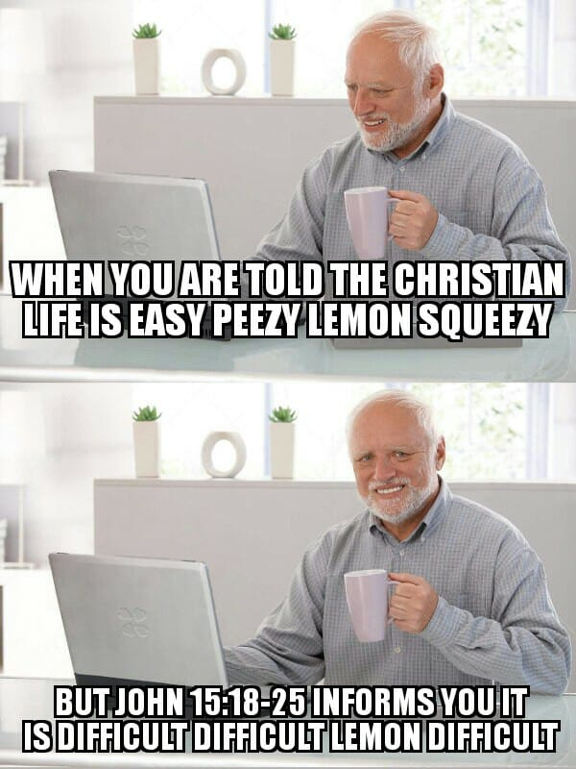

Slide 3
John 16:1-4a
“I have said all these things to you to keep you from falling away. They will put you out of the synagogues. Indeed, the hour is coming when whoever kills you will think he is offering service to God. And they will do these things because they have not known the Father, nor me. But I have said these things to you, that when their hour comes you may remember that I told them to you.

Slide 4
John 16:1-4a
“I have said all these things to you to keep you from falling away. They will put you out of the synagogues. Indeed, the hour is coming when whoever kills you will think he is offering service to God. And they will do these things because they have not known the Father, nor me. But I have said these things to you, that when their hour comes you may remember that I told them to you. (See Acts 5:40-42)

Slide 5
John 16:4b-6
“I did not say these things to you from the beginning, because I was with you. But now I am going to him who sent me, and none of you asks me, ‘Where are you going?’ But because I have said these things to you, sorrow has filled your heart.

Slide 6
The Ministry of the Holy Spirit
Verses 7-15

Slide 7
John 16:7
Nevertheless, I tell you the truth: it is to your advantage that I go away, for if I do not go away, the Helper will not come to you. But if I go, I will send him to you.

Slide 8
John 16:8
And when he comes, he will convict the world concerning sin and righteousness and judgment:

Slide 9
John 16:9
concerning sin, because they do not believe in me;
Romans 3:23 – for all have sinned and fall short of the glory of God,
John 3:18 – Whoever believes in him is not condemned, but whoever does not believe is condemned already, because he has not believed in the name of the only Son of God.

Slide 10
John 16:10
concerning righteousness, because I go to the Father, and you will see me no longer;
Romans 4:5 – And to the one who does not work but believes in him who justifies the ungodly, his faith is counted as righteousness,
Hebrews 1:3b – After making purification for sins, he sat down at the right hand of the Majesty on high,

Slide 11
John 16:11
concerning judgment, because the ruler of this world is judged.
Matthew 25:41 – Then he will say to those on his left, ‘Depart from me, you cursed, into the eternal fire prepared for the devil and his angels.

Slide 12
John 16:12-13
“I still have many things to say to you, but you cannot bear them now. When the Spirit of truth comes, he will guide you into all the truth, for he will not speak on his own authority, but whatever he hears he will speak, and he will declare to you the things that are to come.

Slide 13
John 16:14-15
He will glorify me, for he will take what is mine and declare it to you. All that the Father has is mine; therefore I said that he will take what is mine and declare it to you.

Slide 14
All Scripture Is from God
2 Timothy 3:16 – All Scripture is breathed out by God and profitable for teaching, for reproof, for correction, and for training in righteousness,
2 Peter 1:20-21 – knowing this first of all, that no prophecy of Scripture comes from someone's own interpretation. For no prophecy was ever produced by the will of man, but men spoke from God as they were carried along by the Holy Spirit.

Slide 15
1 Corinthians 2:14-16
The natural person does not accept the things of the Spirit of God, for they are folly to him, and he is not able to understand them because they are spiritually discerned. The spiritual person judges all things, but is himself to be judged by no one. “For who has understood the mind of the Lord so as to instruct him?” But we have the mind of Christ.

Slide 16
The Joy of the Resurrection
Verses 16-22

Slide 17
John 16:16-18
“A little while, and you will see me no longer; and again a little while, and you will see me.” So some of his disciples said to one another, “What is this that he says to us, ‘A little while, and you will not see me, and again a little while, and you will see me’; and, ‘because I am going to the Father’?” So they were saying, “What does he mean by ‘a little while’? We do not know what he is talking about.”

Slide 18
John 16:19-20
Jesus knew that they wanted to ask him, so he said to them, “Is this what you are asking yourselves, what I meant by saying, ‘A little while and you will not see me, and again a little while and you will see me’? Truly, truly, I say to you, you will weep and lament, but the world will rejoice. You will be sorrowful, but your sorrow will turn into joy.

Slide 19
John 16:21-22
When a woman is giving birth, she has sorrow because her hour has come, but when she has delivered the baby, she no longer remembers the anguish, for joy that a human being has been born into the world. So also you have sorrow now, but I will see you again, and your hearts will rejoice, and no one will take your joy from you.

Slide 20
1 Peter 1:3-4
Blessed be the God and Father of our Lord Jesus Christ! According to his great mercy, he has caused us to be born again to a living hope through the resurrection of Jesus Christ from the dead, to an inheritance that is imperishable, undefiled, and unfading, kept in heaven for you,

Slide 21
1 Peter 1:5-6
who by God's power are being guarded through faith for a salvation ready to be revealed in the last time. In this you rejoice, though now for a little while, if necessary, you have been grieved by various trials,

Slide 22
Prayer in Jesus’ Name
Verses 23-28

Slide 23
John 16:23-24
In that day you will ask nothing of me. Truly, truly, I say to you, whatever you ask of the Father in my name, he will give it to you. Until now you have asked nothing in my name. Ask, and you will receive, that your joy may be full.

Slide 24
John 16:25-26
“I have said these things to you in figures of speech. The hour is coming when I will no longer speak to you in figures of speech but will tell you plainly about the Father. In that day you will ask in my name, and I do not say to you that I will ask the Father on your behalf;

Slide 25
John 16:27-28
for the Father himself loves you*, because you have loved me and have believed that I came from God. I came from the Father and have come into the world, and now I am leaving the world and going to the Father.”
*John 17:23b – …so that the world may know that you sent me and loved them even as you loved me.

Slide 26
Romans 8:26-27
Likewise the Spirit helps us in our weakness. For we do not know what to pray for as we ought, but the Spirit himself intercedes for us with groanings too deep for words. And he who searches hearts knows what is the mind of the Spirit, because[g] the Spirit intercedes for the saints according to the will of God.

Slide 27
The Father’s Sovereignty
Verses 29-33

Slide 28
John 16:29-30
His disciples said, “Ah, now you are speaking plainly and not using figurative speech! Now we know that you know all things and do not need anyone to question you; this is why we believe that you came from God.”
Proverbs 16:18 – Pride goes before destruction,
and a haughty spirit before a fall.

Slide 29
John 16:31-32a
Jesus answered them, “Do you now believe? Behold, the hour is coming, indeed it has come, when you will be scattered, each to his own home, and will leave me alone.

Slide 30
John 16:32b-33
Yet I am not alone, for the Father is with me. I have said these things to you, that in me you may have peace. In the world you will have tribulation. But take heart; I have overcome the world.”

Slide 31
Four Comforts
The Ministry of the Holy Spirit
The Joy of the Resurrection
Prayer in Jesus’ Name
The Father’s Sovereignty

