Slide 1
The High Priestly Prayer (Part 2)
John 17:13-19

Slide 2



Slide 3
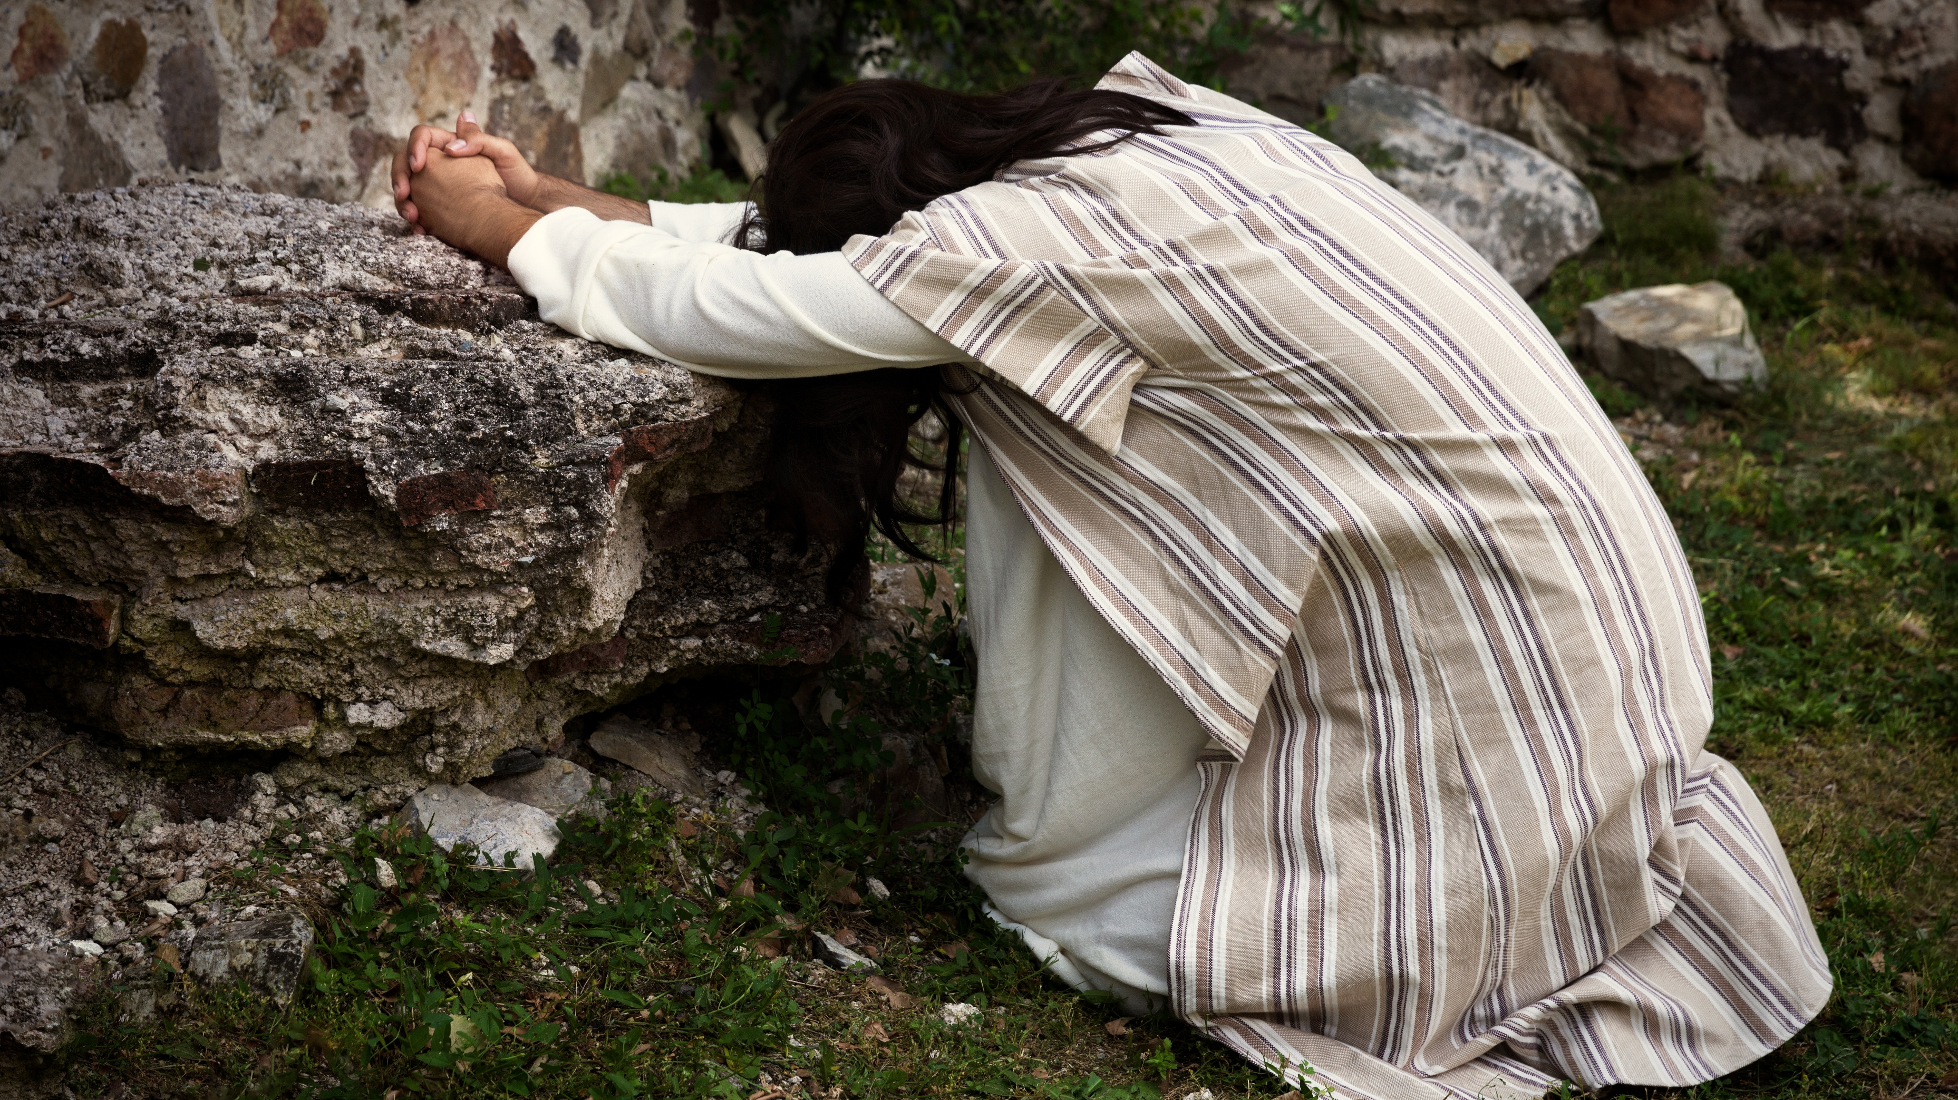

Slide 4
Sanctification
Being made holy / being set apart
Being set apart from sin
Being set apart to God

Slide 5
Joy
Verse 13

Slide 6
John 17:13
But now I am coming to you, and these things I speak in the world, that they may have my joy fulfilled in themselves.

Slide 7
John 10:10
The thief comes only to steal and kill and destroy. I came that they may have life and have it abundantly*.
*or to the full.

Slide 8
Psalm 37:4-6
Delight yourself in the Lord,
and he will give you the desires of your heart.
Commit your way to the Lord;
trust in him, and he will act.
He will bring forth your righteousness as the light,
and your justice as the noonday.

Slide 9
Protection
Verses 14-16

Slide 10
John 17:14-16
I have given them your word, and the world has hated them because they are not of the world, just as I am not of the world. I do not ask that you take them out of the world, but that you keep them from the evil one. They are not of the world, just as I am not of the world.
(see also 1 Corinthians 5:9-13)

Slide 11
Sanctification
Verses 17-19

Slide 12
John 17:17
Sanctify them in the truth; your word is truth.

Slide 13
Marriage & Sexuality
Anything goes as long as all participants are consenting adults

Slide 14
Marriage – Mark 10:6-9
But from the beginning of creation, ‘God made them male and female.’ ‘Therefore a man shall leave his father and mother and hold fast to his wife, and the two shall become one flesh.’ So they are no longer two but one flesh. What therefore God has joined together, let not man separate.”

Slide 15
Married Sexuality vs. Immorality
Hebrews 13:4 – Let marriage be held in honor among all, and let the marriage bed be undefiled, for God will judge the sexually immoral and adulterous.
1 Corinthians 7:2 – But because of the temptation to sexual immorality, each man should have his own wife and each woman her own husband.

Slide 16
Wealth & Possessions
The goal in life is to accumulate enough stuff to lead a comfortable life.

Slide 17
Contentment – 1 Timothy 6:8-10
But if we have food and clothing, with these we will be content. But those who desire to be rich fall into temptation, into a snare, into many senseless and harmful desires that plunge people into ruin and destruction. For the love of money is a root of all kinds of evils. It is through this craving that some have wandered away from the faith and pierced themselves with many pangs.

Slide 18
Generosity – 1 Corinthians 9:6-8
The point is this: whoever sows sparingly will also reap sparingly, and whoever sows bountifully will also reap bountifully. Each one must give as he has decided in his heart, not reluctantly or under compulsion, for God loves a cheerful giver. And God is able to make all grace abound to you, so that having all sufficiency in all things at all times, you may abound in every good work.

Slide 19
Treasure in Heaven – Matthew 6:19-21
“Do not lay up for yourselves treasures on earth, where moth and rust destroy and where thieves break in and steal, but lay up for yourselves treasures in heaven, where neither moth nor rust destroys and where thieves do not break in and steal. For where your treasure is, there your heart will be also.

Slide 20
Speech & Communication
Profanity is just a way to express strong feelings
Insults, mockery, slander, and rage are a regular part of communication (especially online)

Slide 21
Speech & Genuine Faith – James 1:26
If anyone thinks he is religious and does not bridle his tongue but deceives his heart, this person's religion is worthless.

Slide 22
Edifying Speech – Ephesians 4:29-32
Let no corrupting talk come out of your mouths, but only such as is good for building up, as fits the occasion, that it may give grace to those who hear. And do not grieve the Holy Spirit of God, by whom you were sealed for the day of redemption. Let all bitterness and wrath and anger and clamor and slander be put away from you, along with all malice. Be kind to one another, tenderhearted, forgiving one another, as God in Christ forgave you.

Slide 23
Pure Speech – Ephesians 4:29-32
Let there be no filthiness nor foolish talk nor crude joking, which are out of place, but instead let there be thanksgiving.

Slide 24
Gentle & Kind Speech – 2 Timothy 2:23-26
Have nothing to do with foolish, ignorant controversies; you know that they breed quarrels. And the Lord's servant must not be quarrelsome but kind to everyone, able to teach, patiently enduring evil, correcting his opponents with gentleness. God may perhaps grant them repentance leading to a knowledge of the truth, and they may come to their senses and escape from the snare of the devil, after being captured by him to do his will.

Slide 25
Prejudice & Double Standards
“Those people” are undeserving of compassion, respect, legal protection, life…
“Those people” are so bad that it justifies anything said or done by “my people.”

Slide 26
Impartiality – James 2:8-9…12-13
If you really fulfill the royal law according to the Scripture, “You shall love your neighbor as yourself,” you are doing well. But if you show partiality, you are committing sin and are convicted by the law as transgressors… So speak and so act as those who are to be judged under the law of liberty. For judgment is without mercy to one who has shown no mercy. Mercy triumphs over judgment.

Slide 27
Integrity – Ephesians 5:7-11
Therefore do not become partners with them; for at one time you were darkness, but now you are light in the Lord. Walk as children of light (for the fruit of light is found in all that is good and right and true), and try to discern what is pleasing to the Lord. Take no part in the unfruitful works of darkness, but instead expose them.

Slide 28
John 17:17
Sanctify them in the truth; your word is truth.

Slide 29
John 17:18-19
As you sent me into the world, so I have sent them into the world. And for their sake I consecrate myself, that they also may be sanctified in truth.

Slide 30
1 John 3:1-3
See what kind of love the Father has given to us, that we should be called children of God; and so we are. The reason why the world does not know us is that it did not know him. Beloved, we are God's children now, and what we will be has not yet appeared; but we know that when he appears we shall be like him, because we shall see him as he is. And everyone who thus hopes in him purifies himself as he is pure.

Slide 31
Application Questions
Am I acting like the visible, physical presence of Jesus Christ in the world?
Am I pursuing sanctification?
  Is the Word of God a daily part of my life?
  Is there any worldly behavior I need to take off?
  Is there any godly behavior I need to put on?

